Slide 1

Start Menu
Save 1
Save2
Save 3

Slide 2
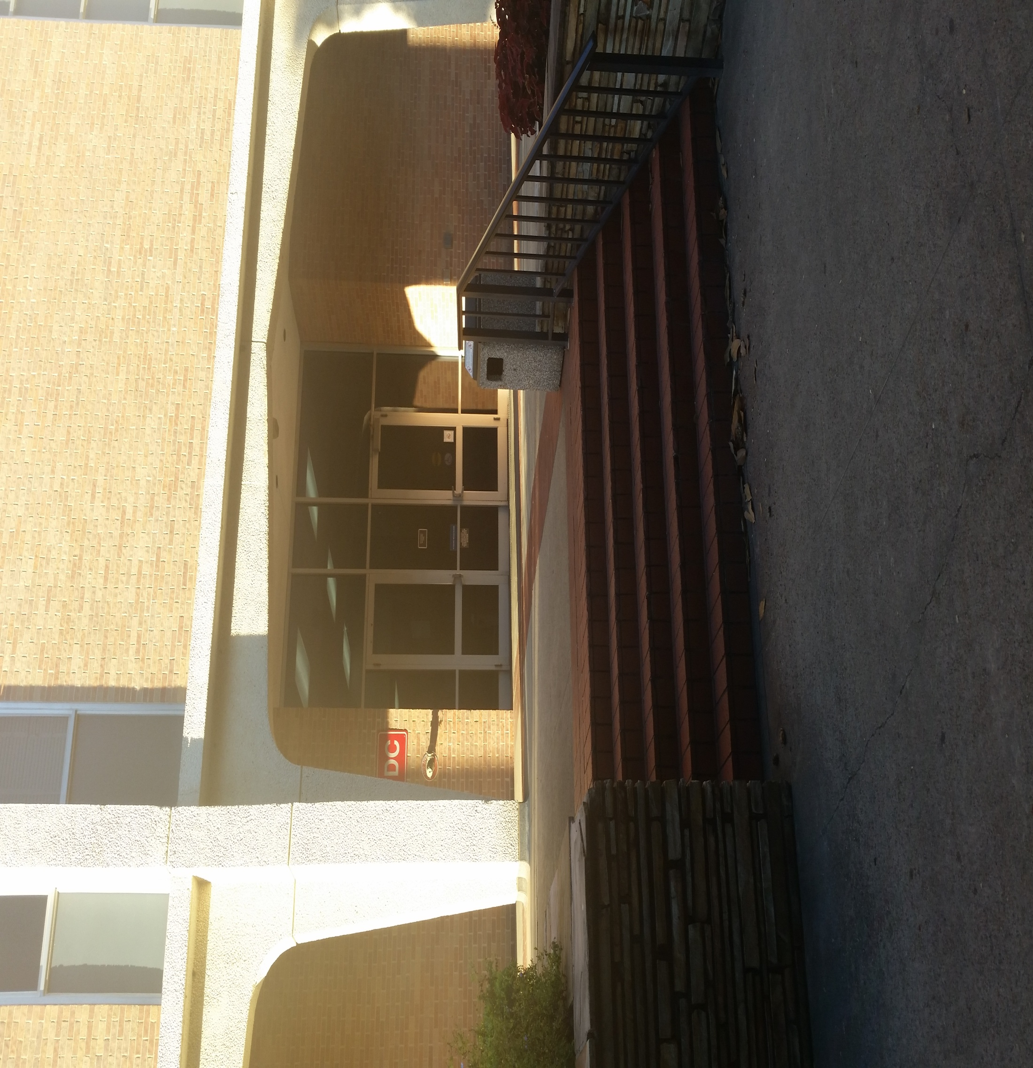
Front of ab1

Slide 3
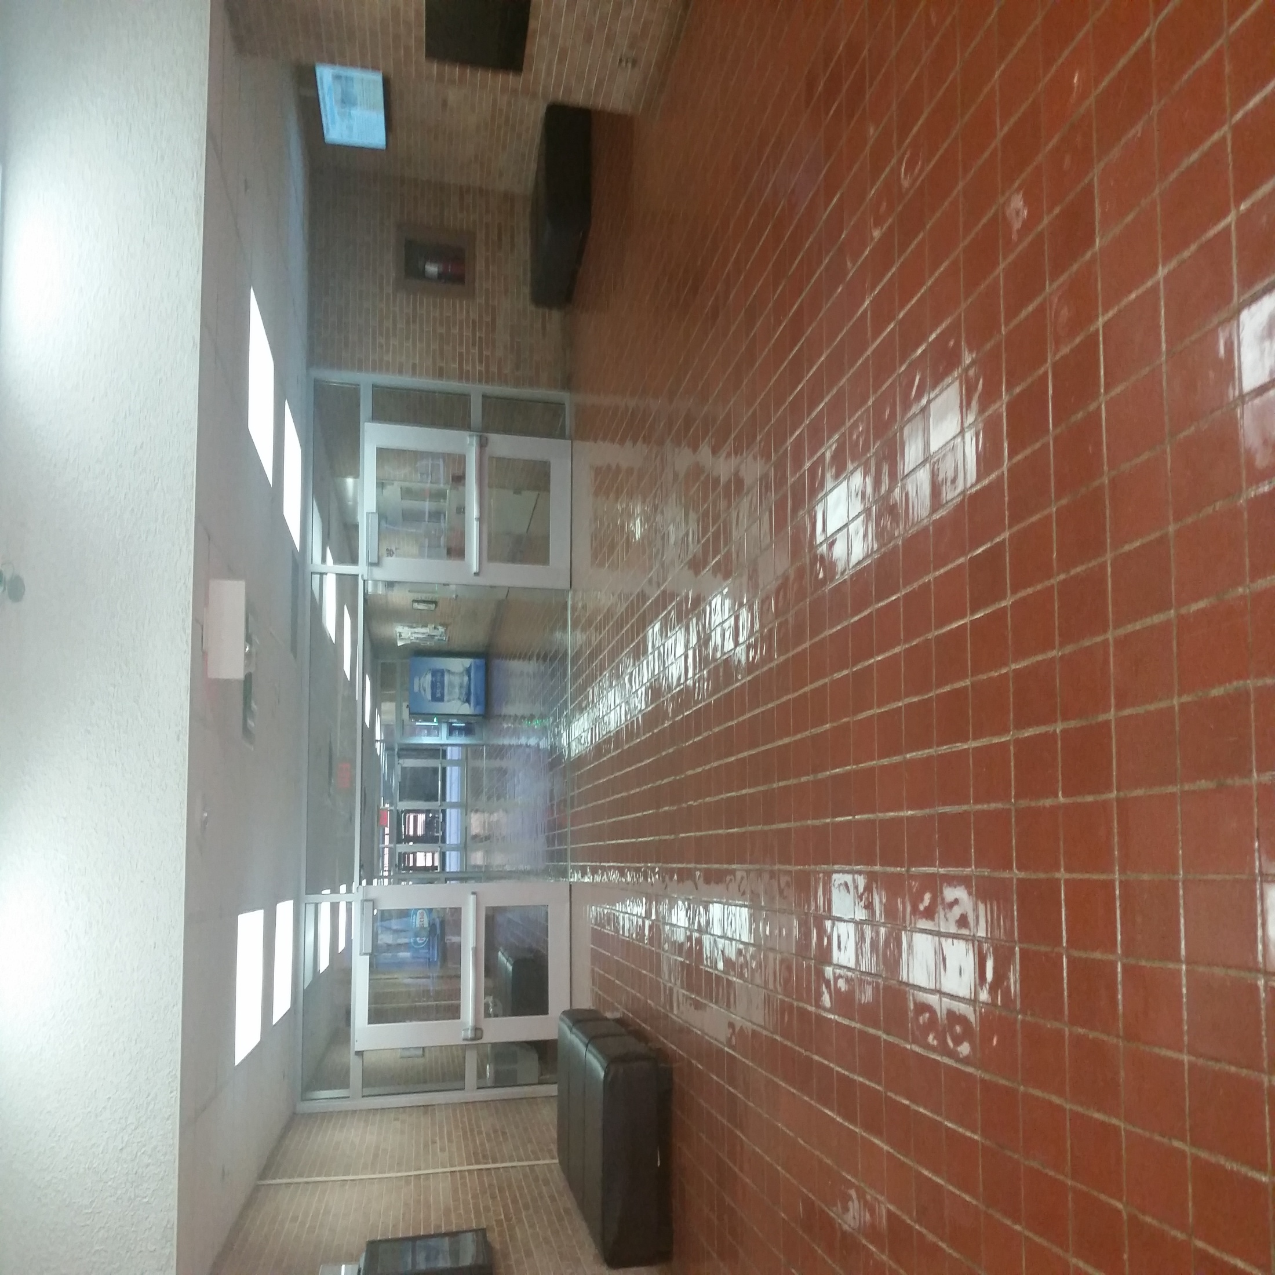
Just Inside doors of AB1

Slide 4
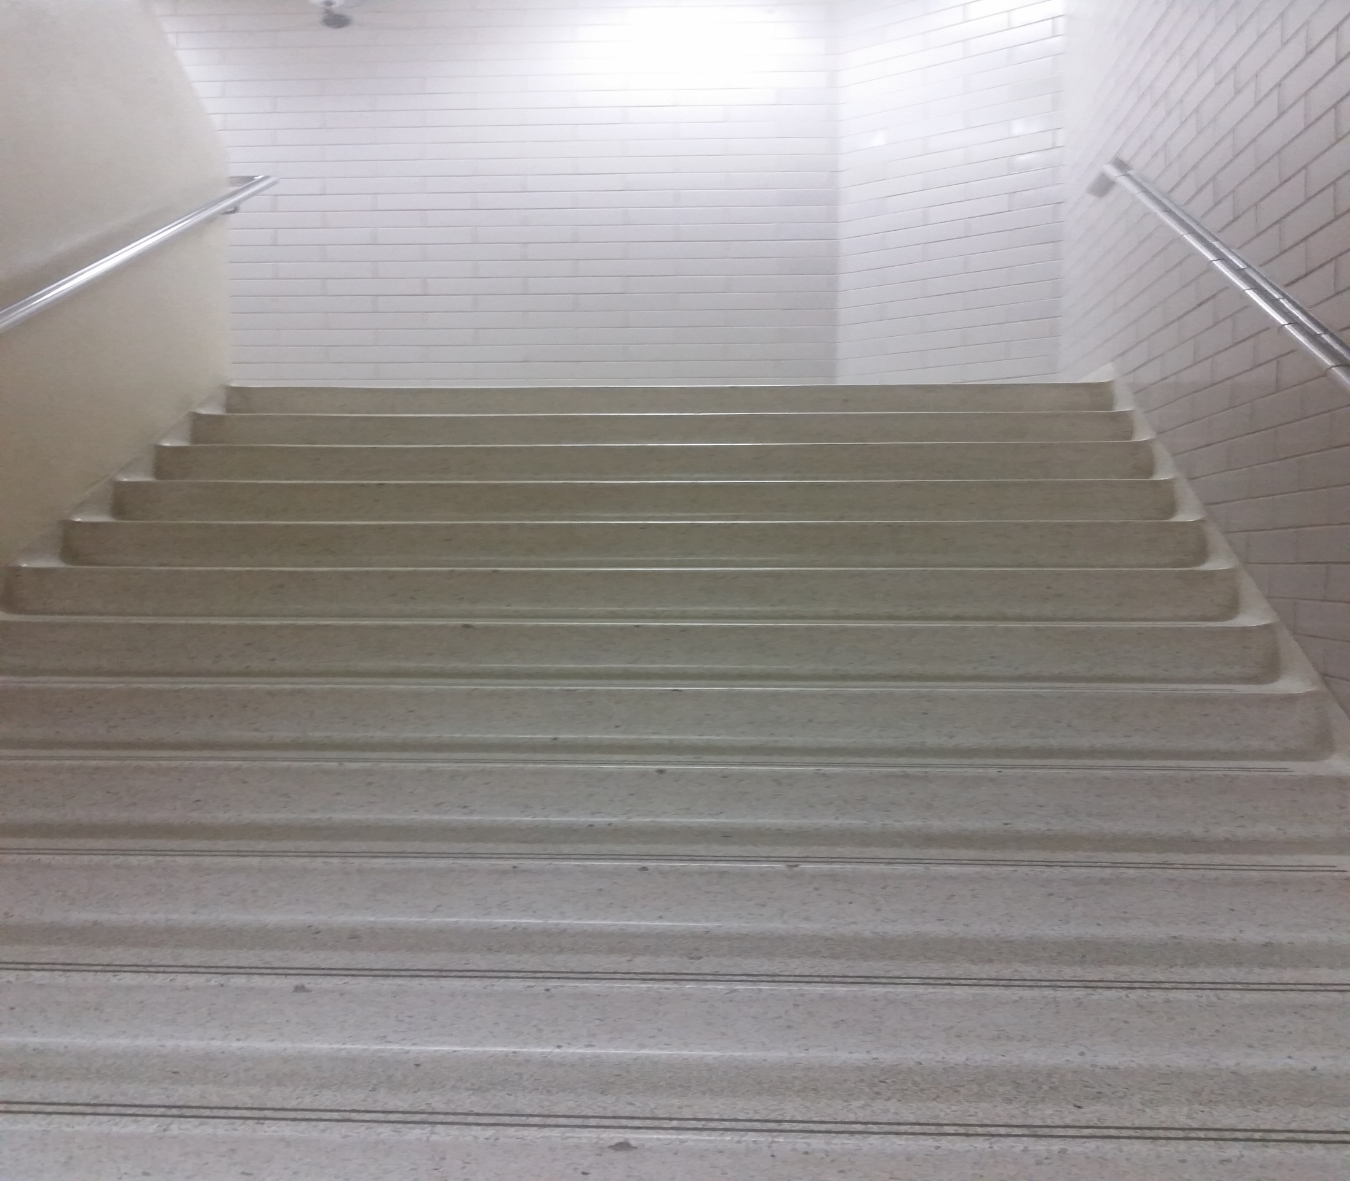
Stairs looking up pt1

Slide 5
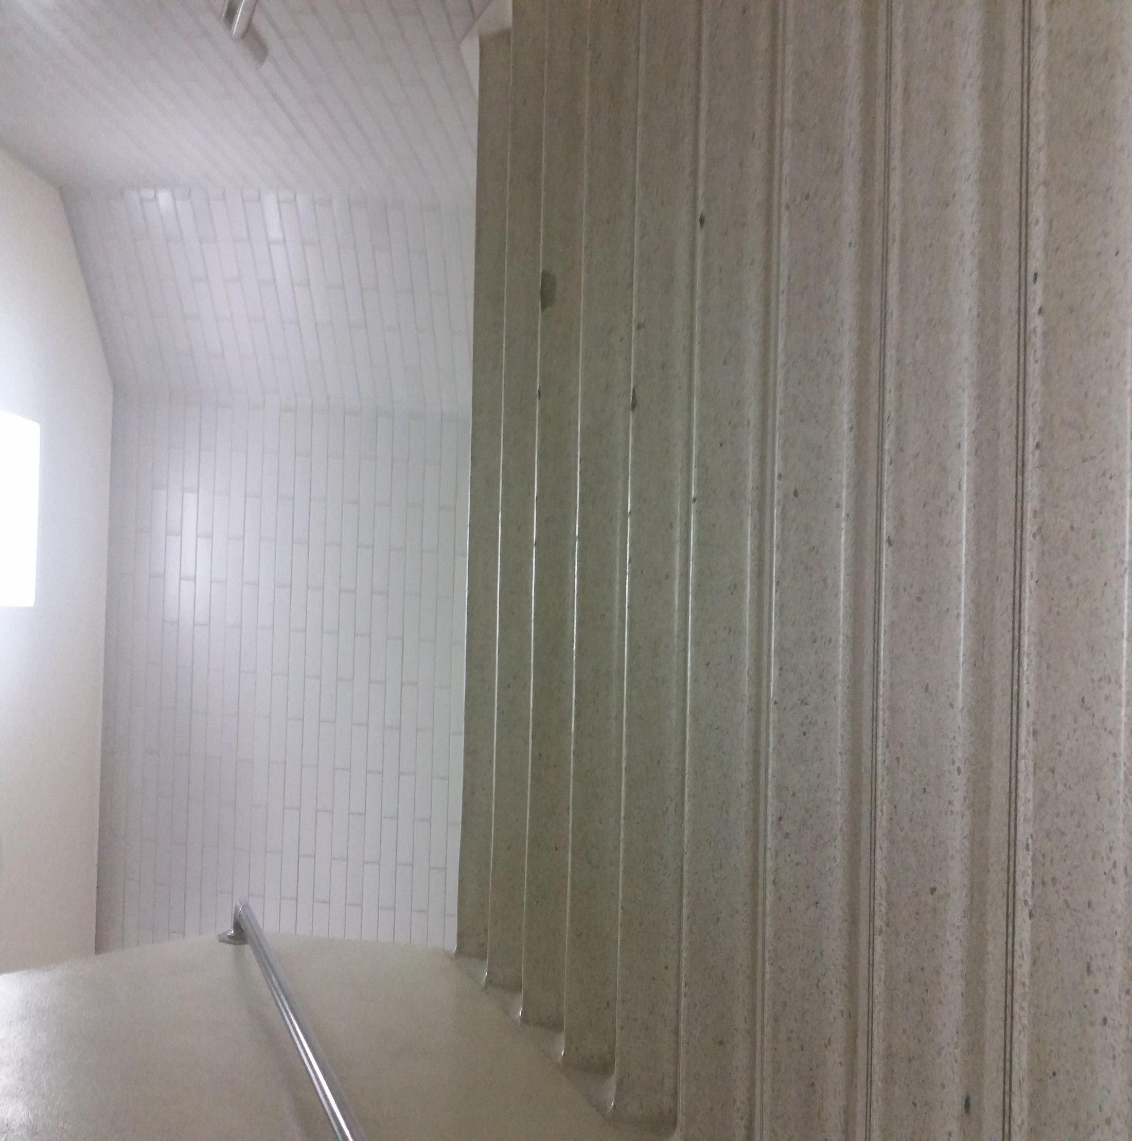
Stairs looking up pt2

Slide 6
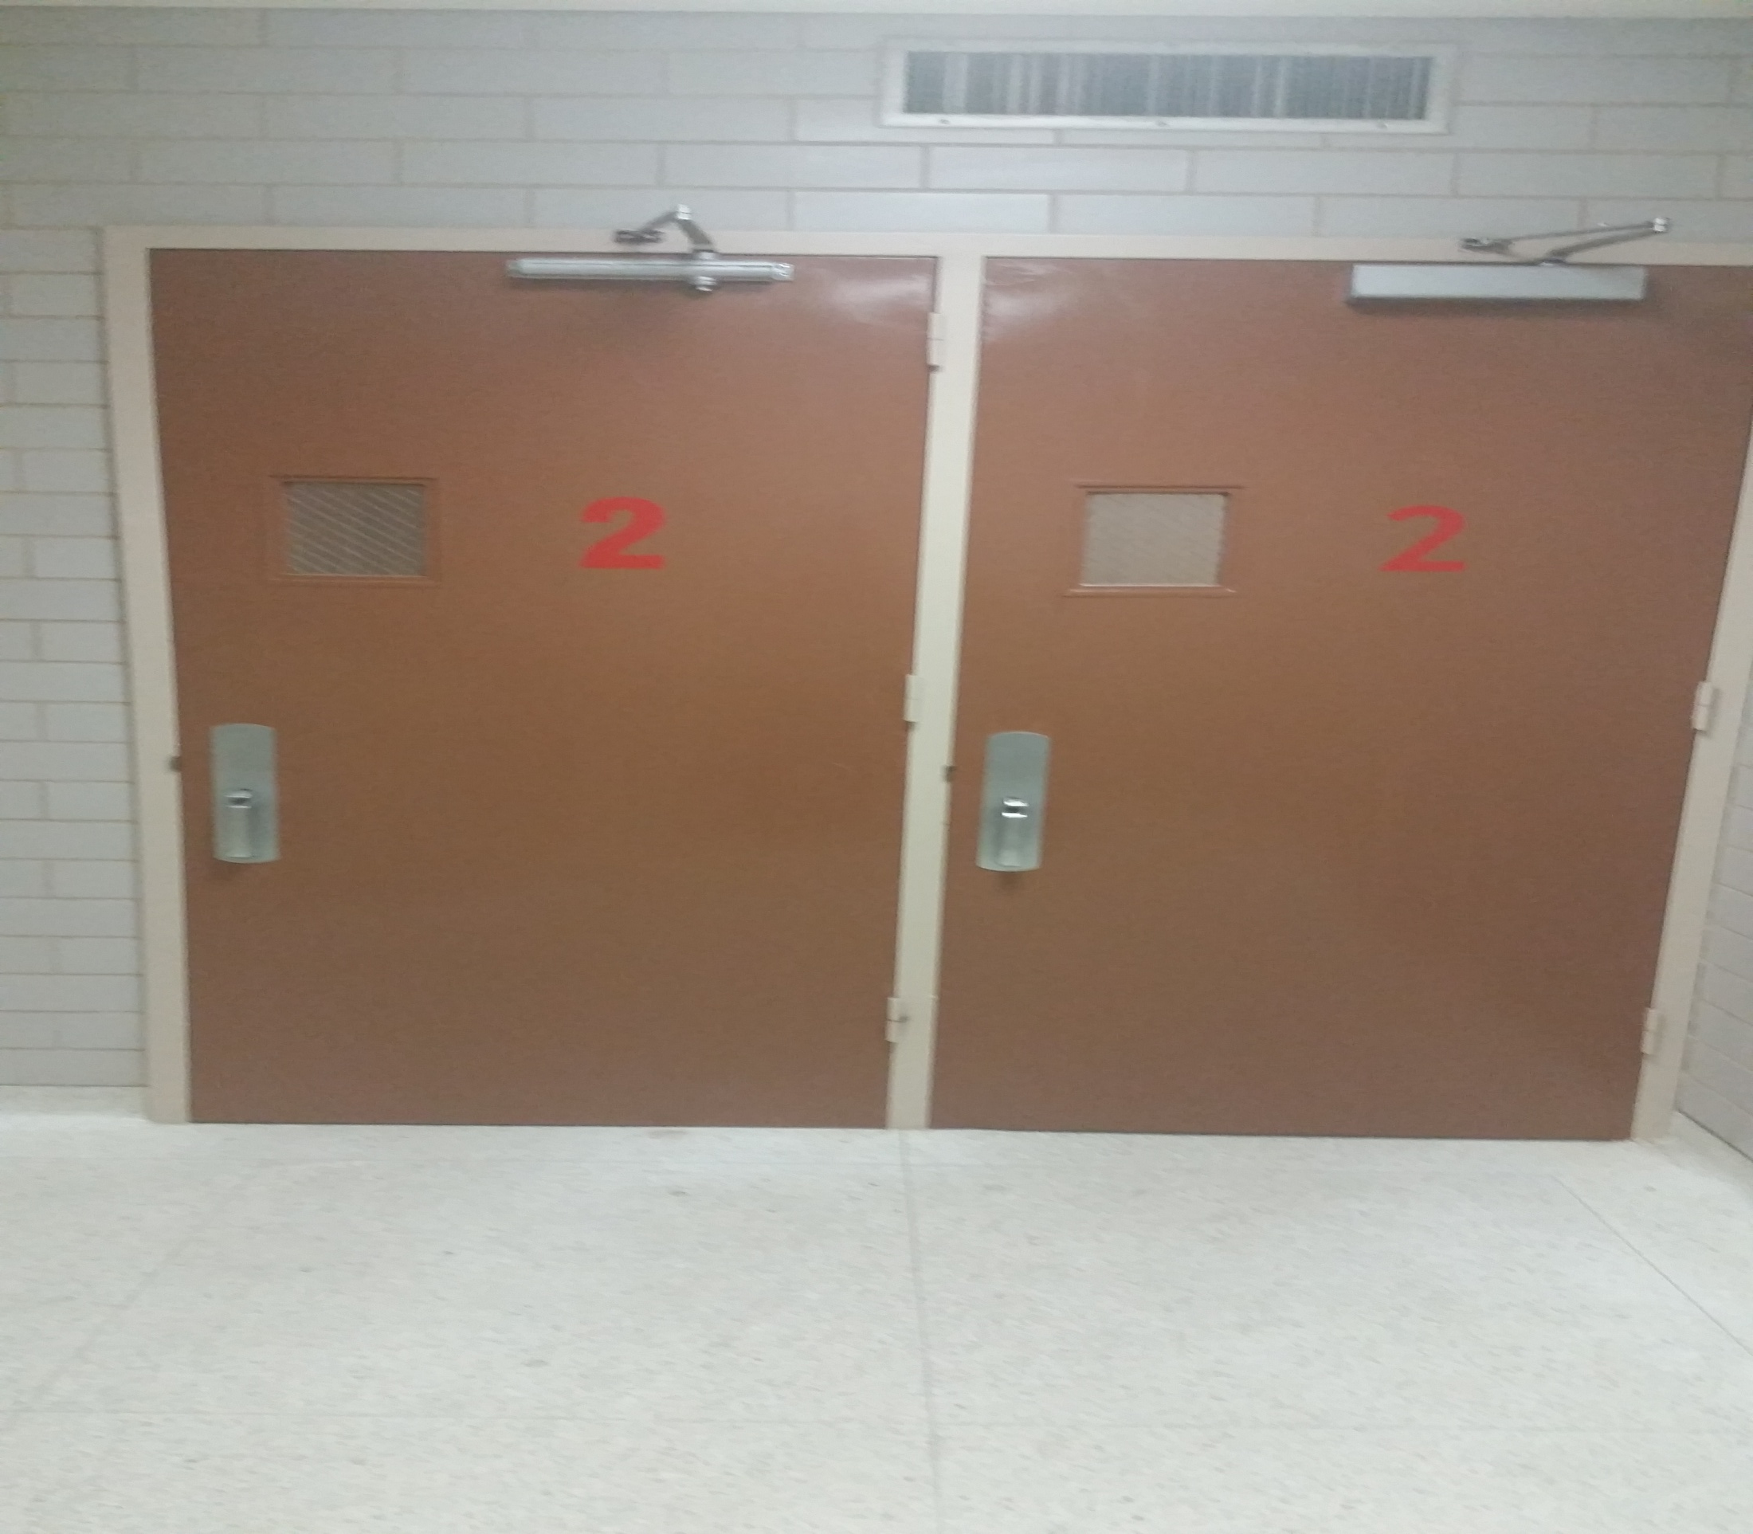
Top of stairs

Slide 7
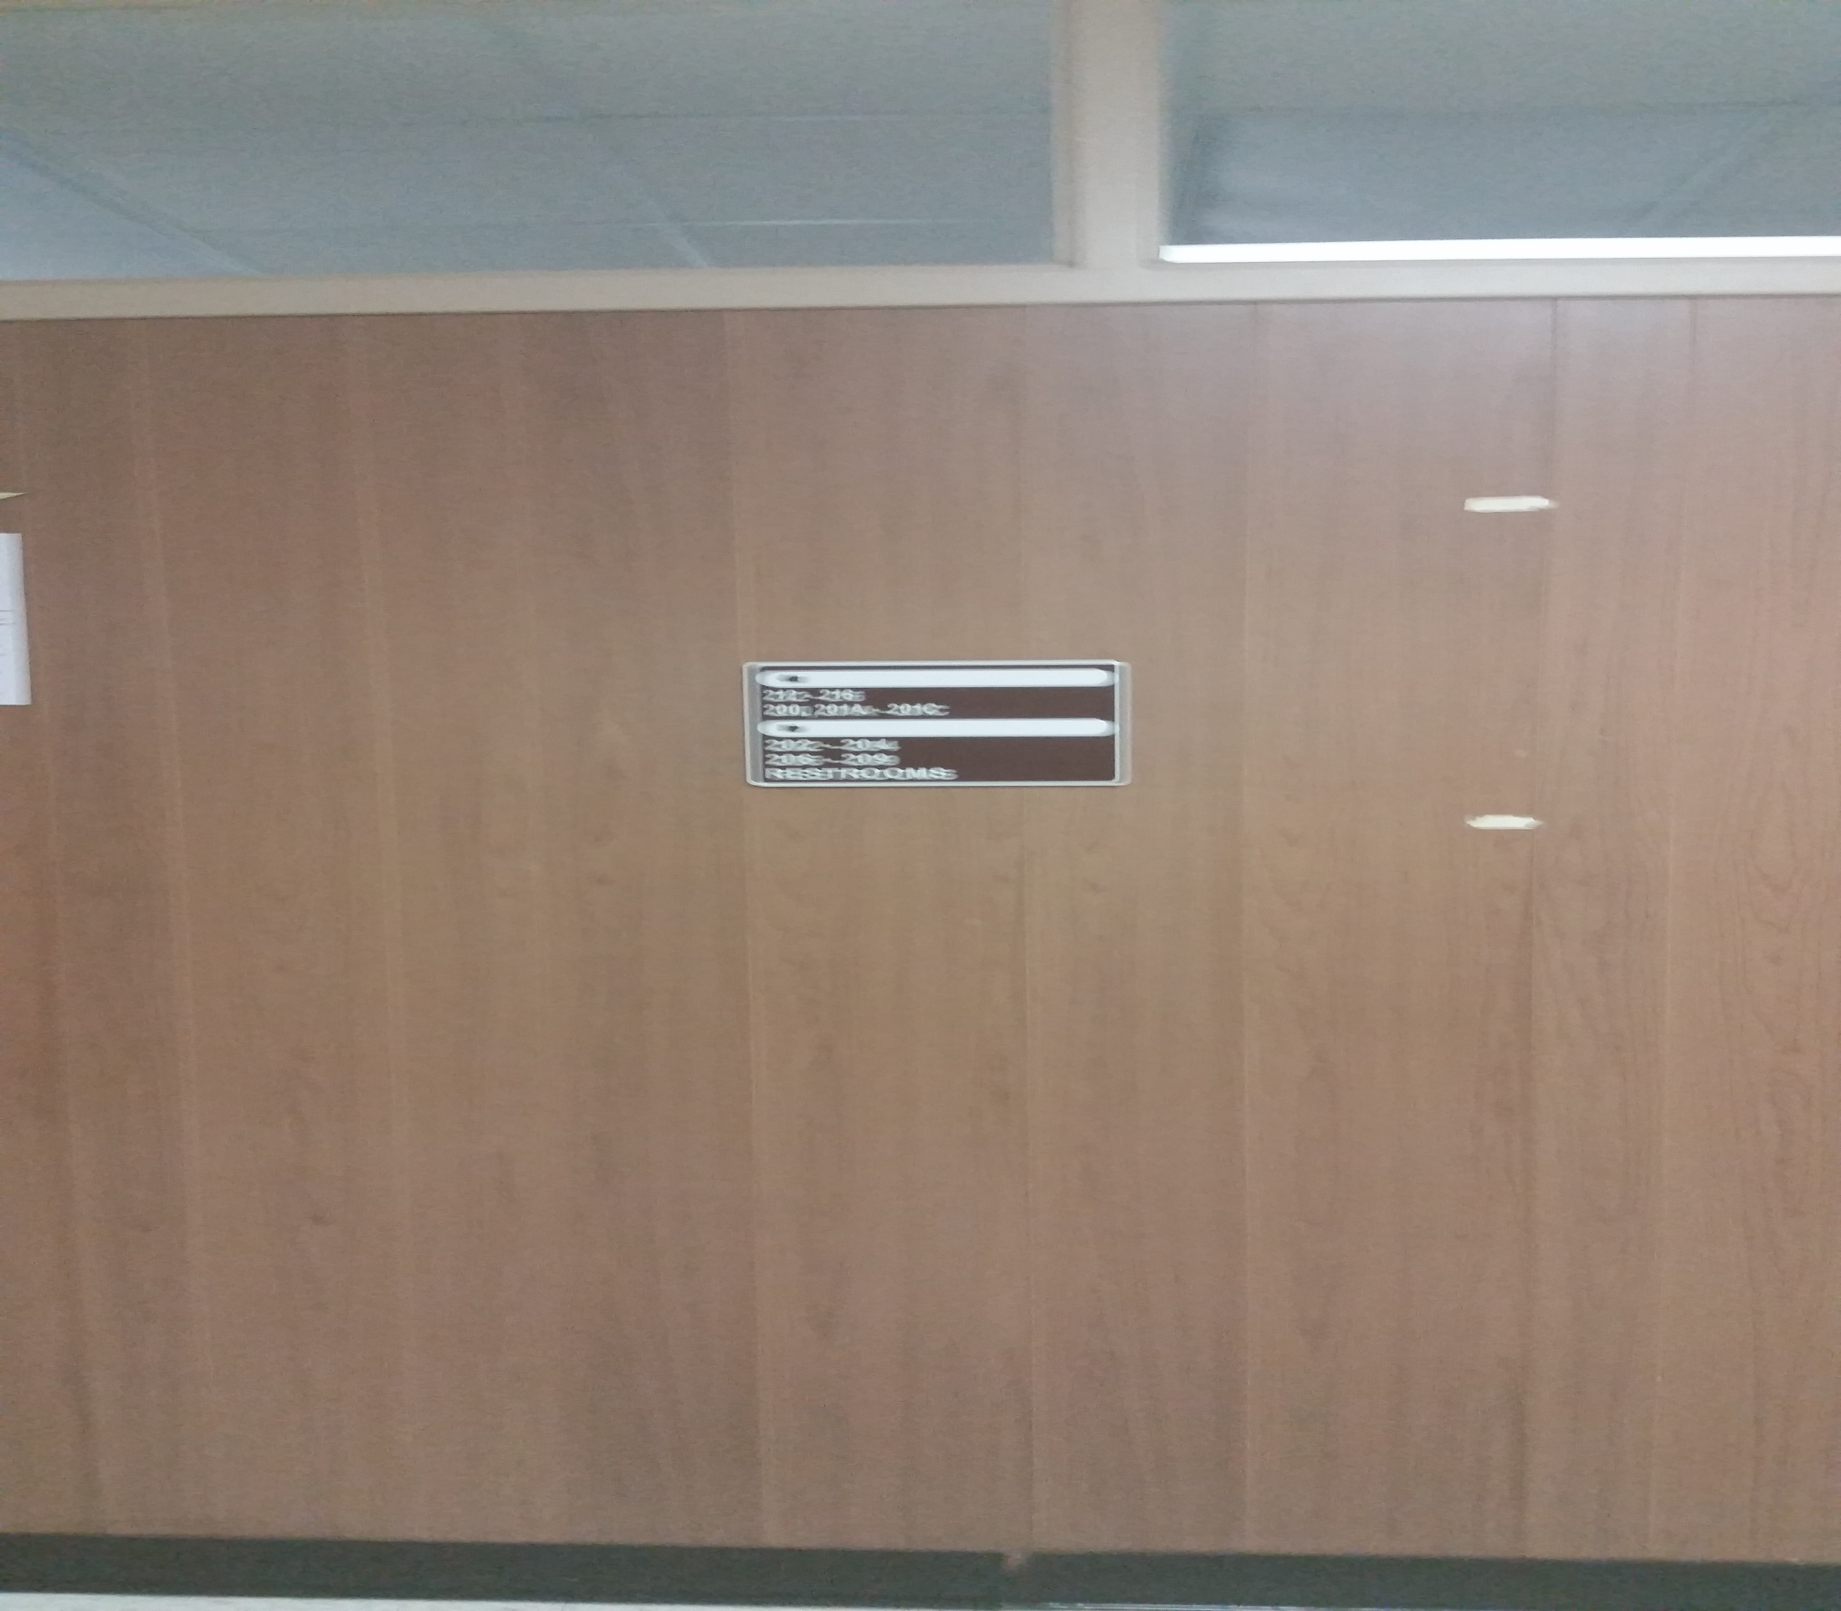
Outside stair door

Slide 8
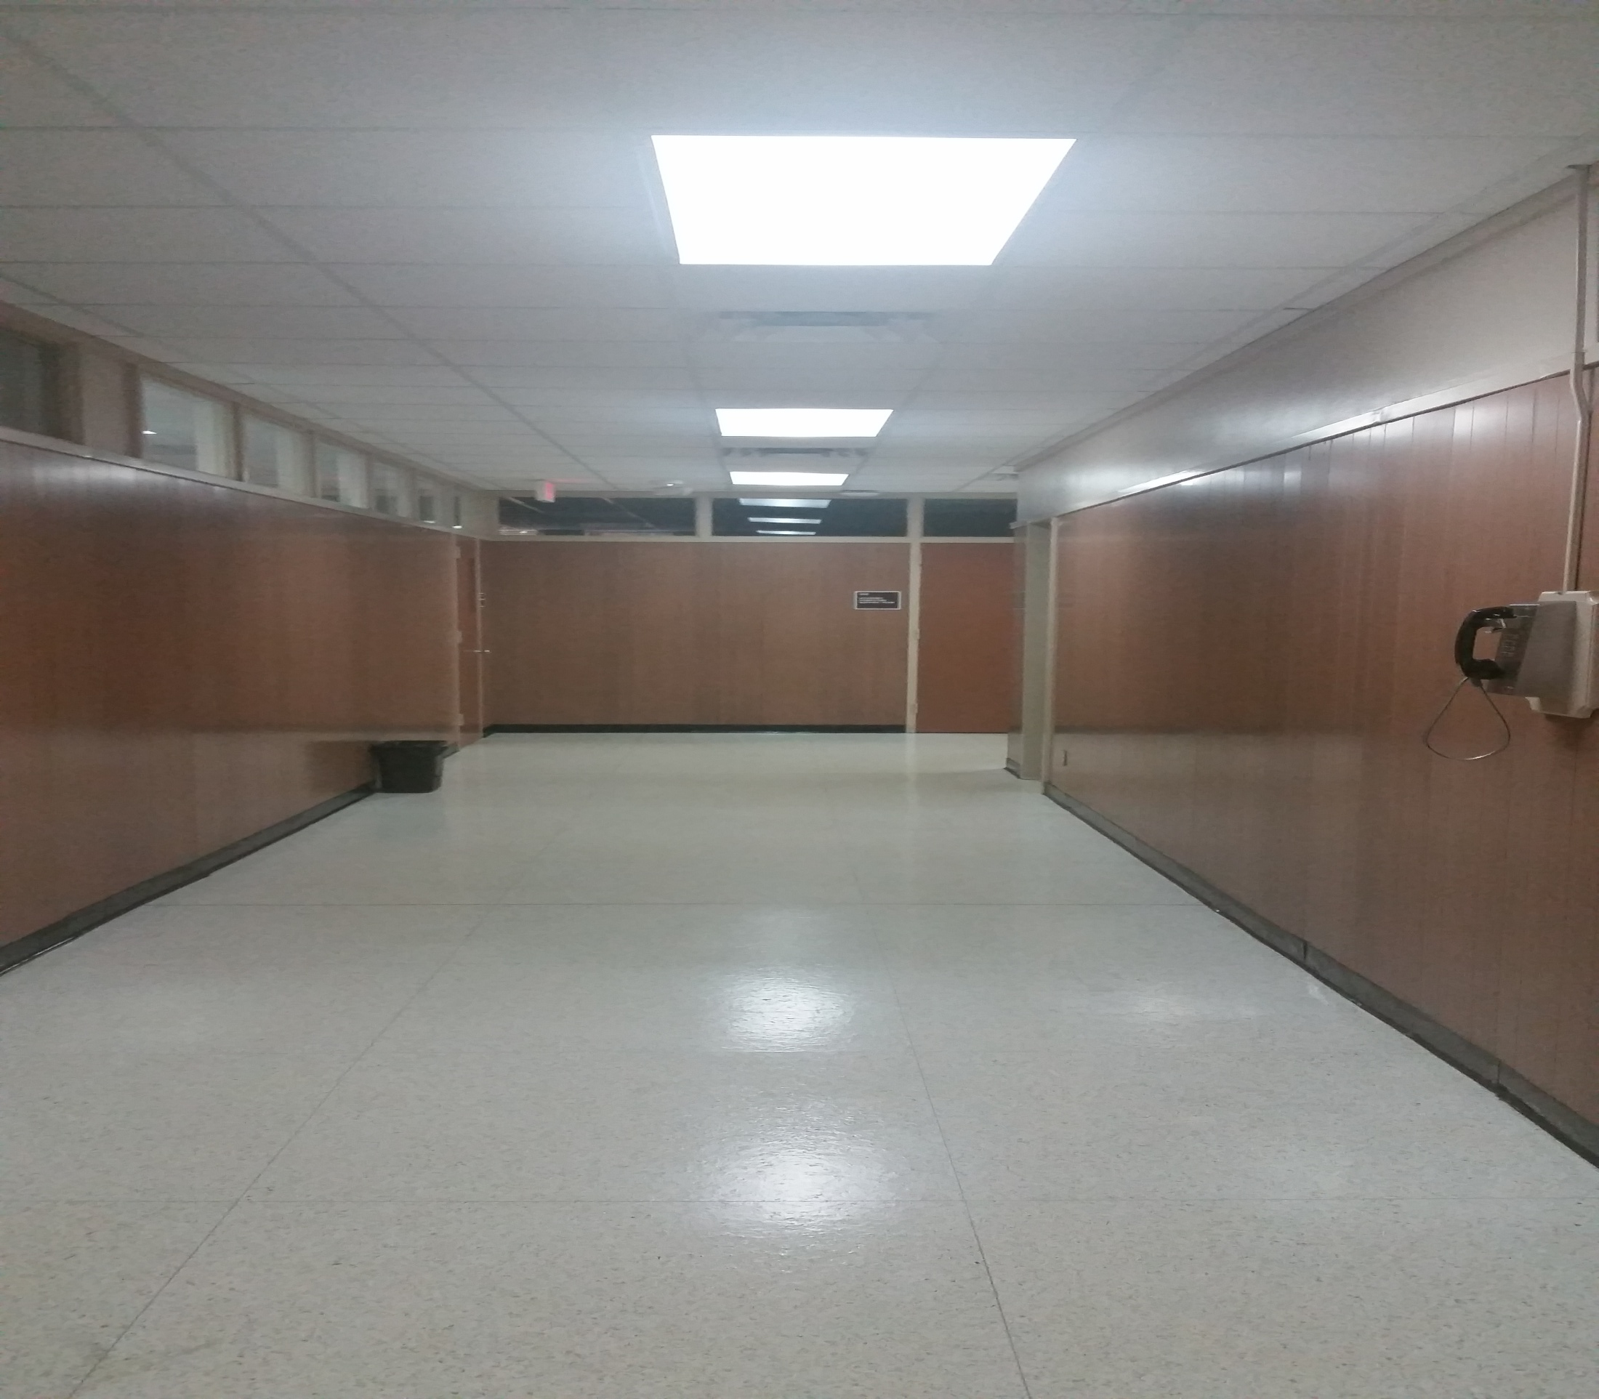
Right 1

Slide 9
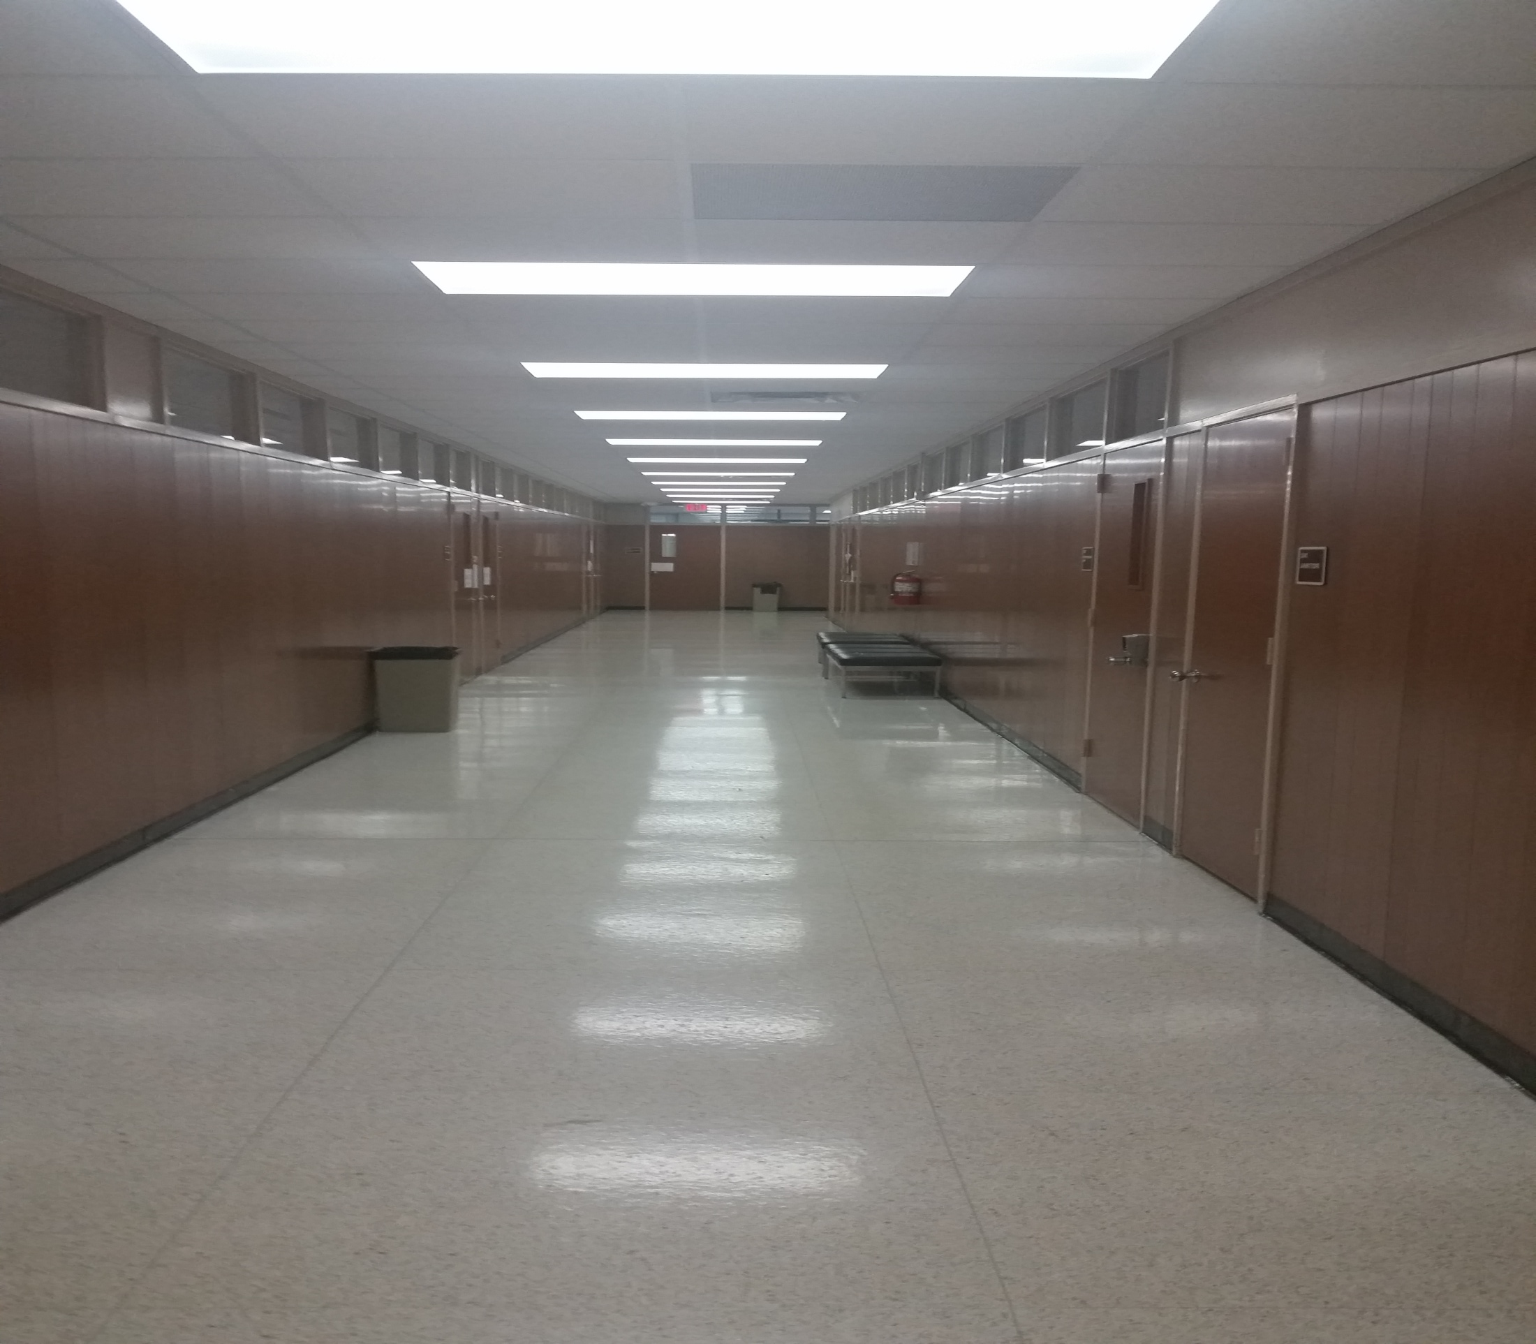
Right 2

Slide 10
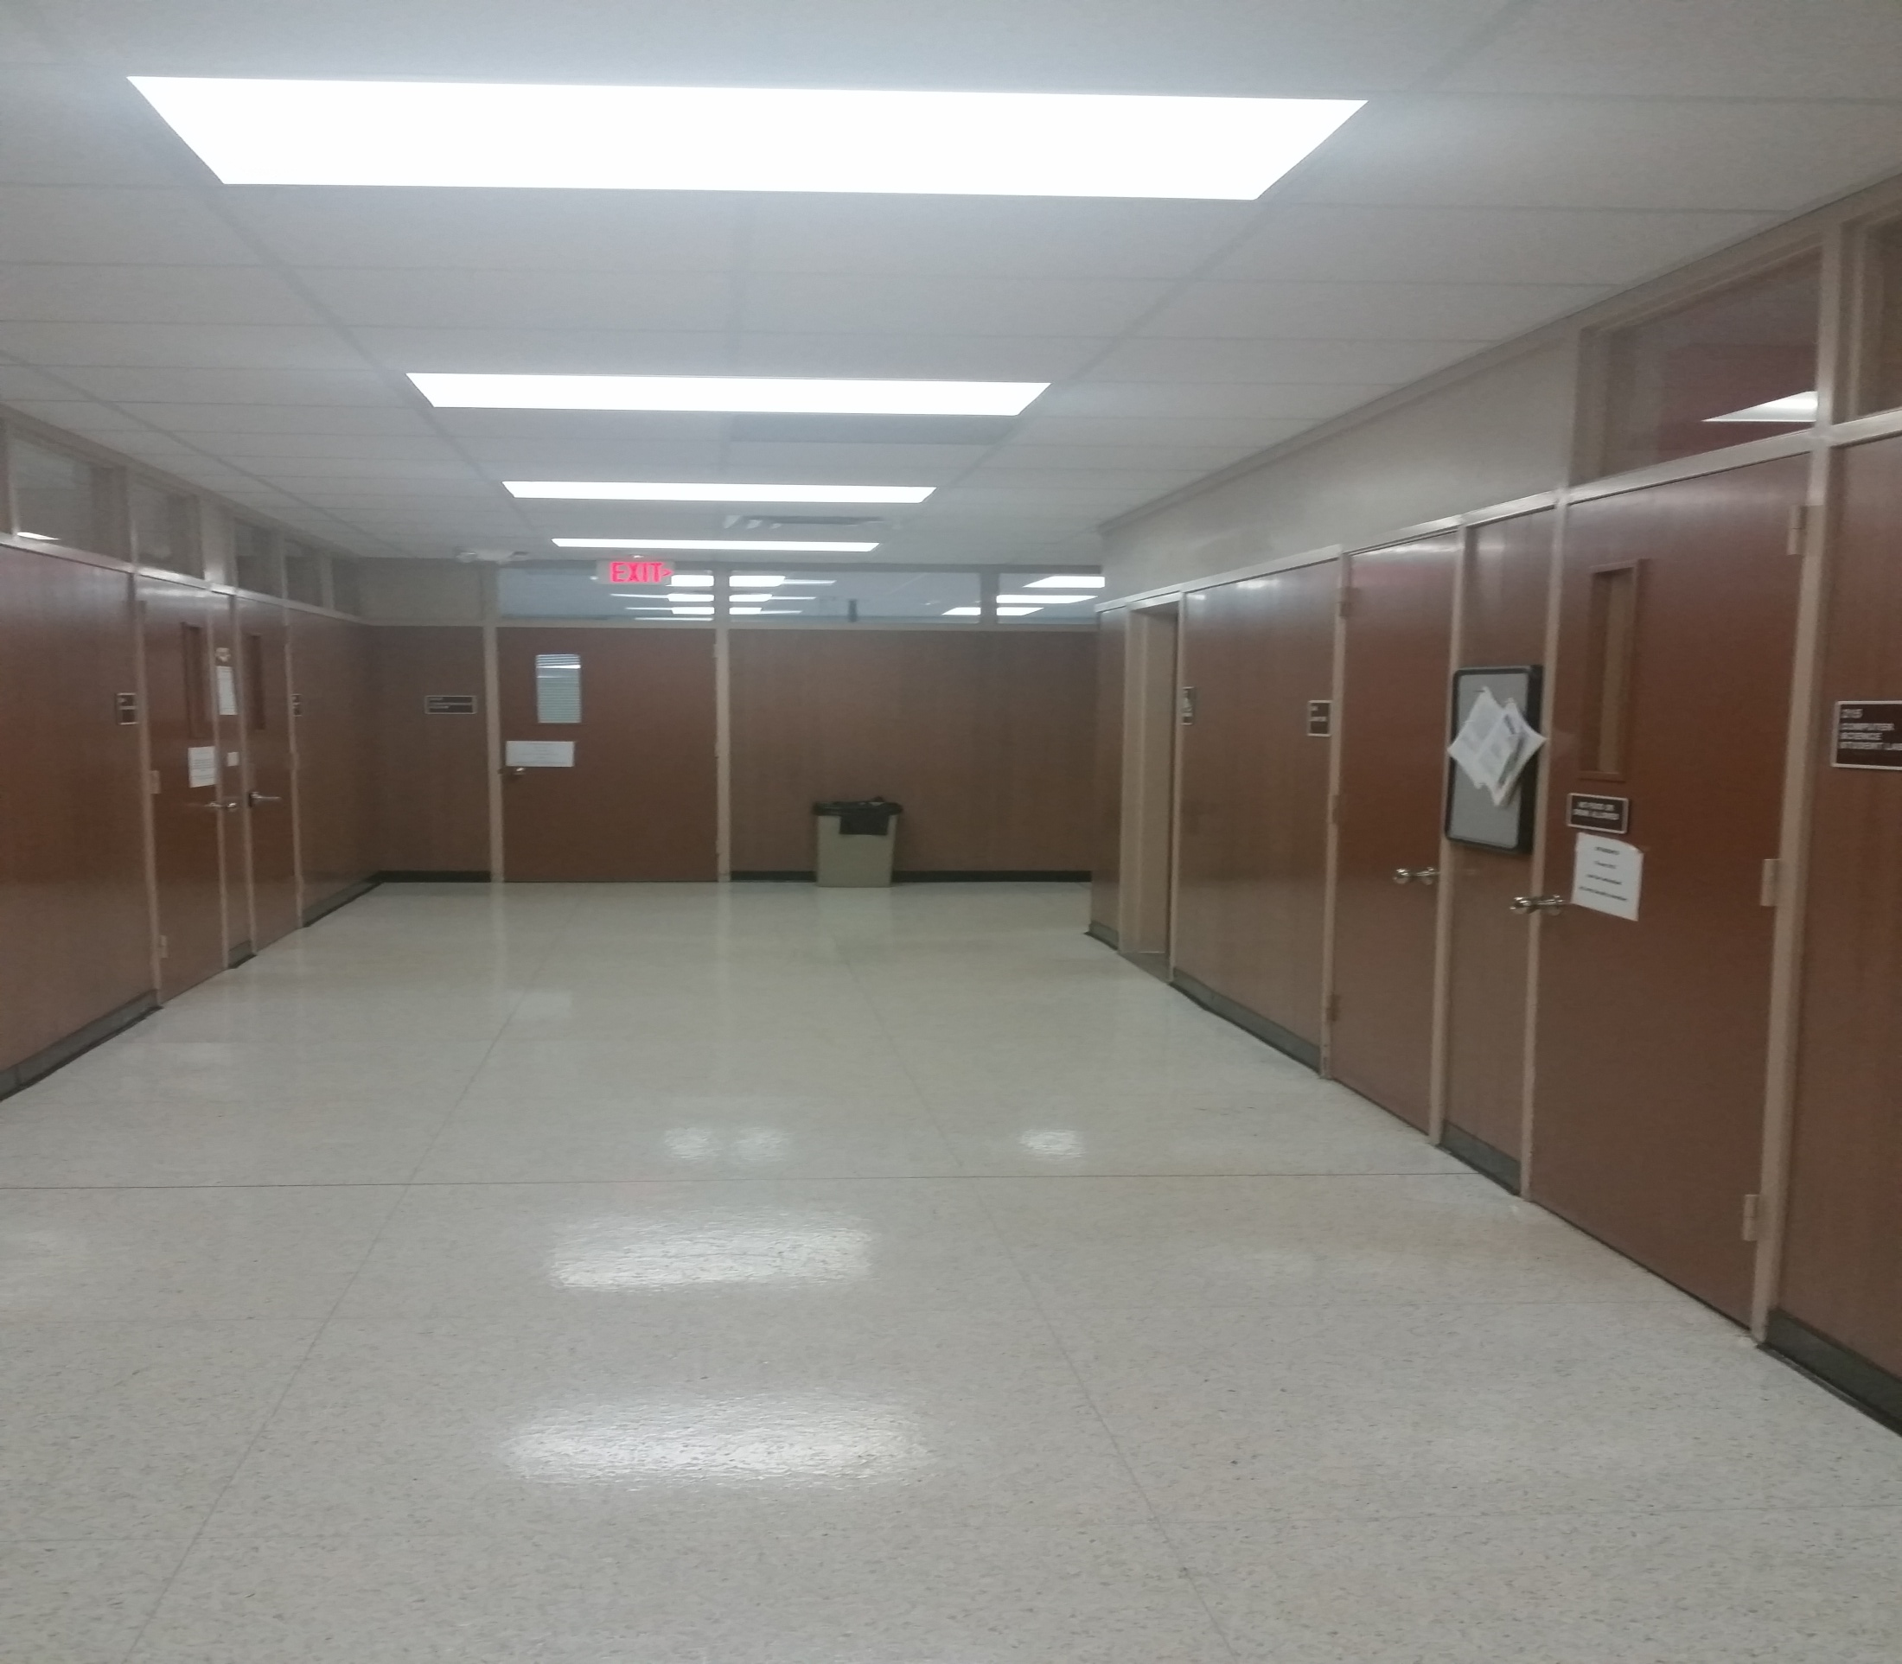
Right 3

Slide 11
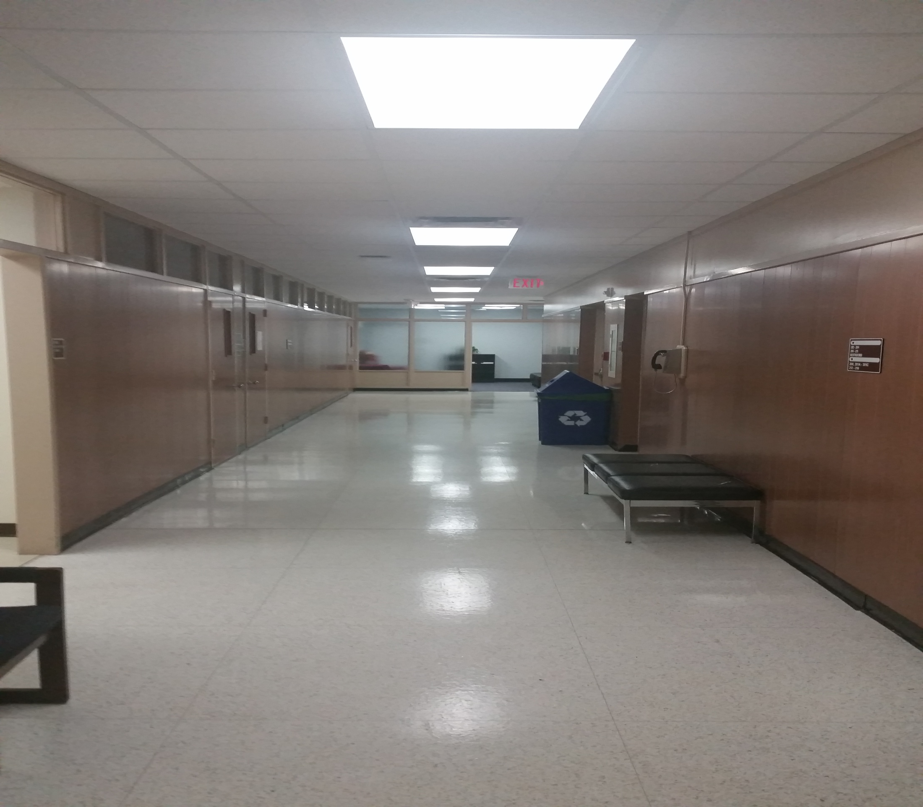
Right 4

Slide 12
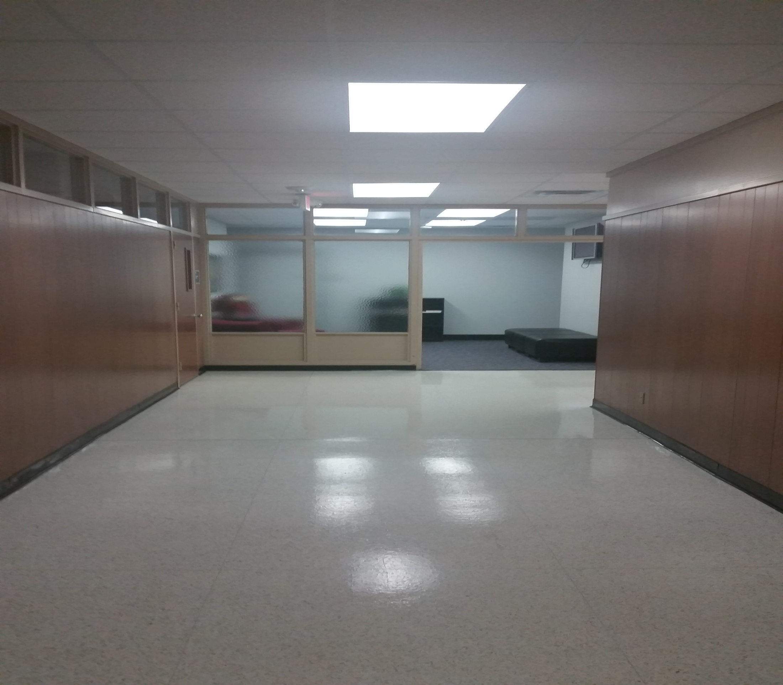
Right 5

Slide 13
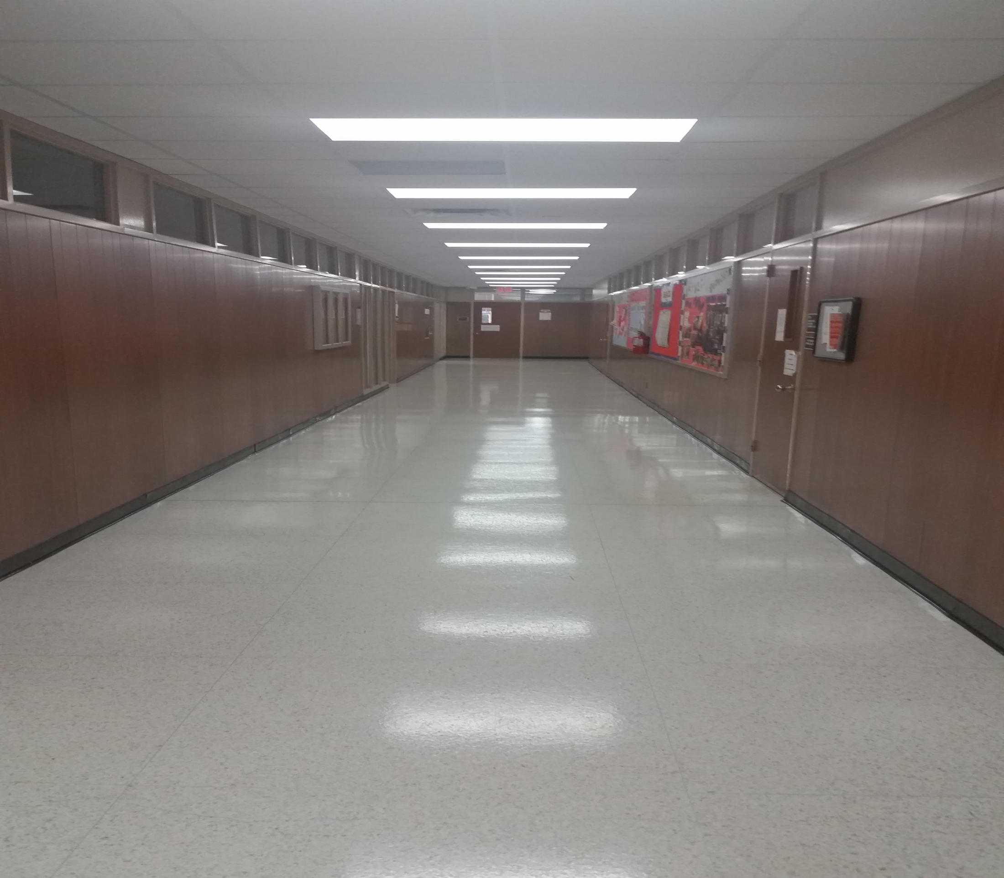
Right 6

Slide 14
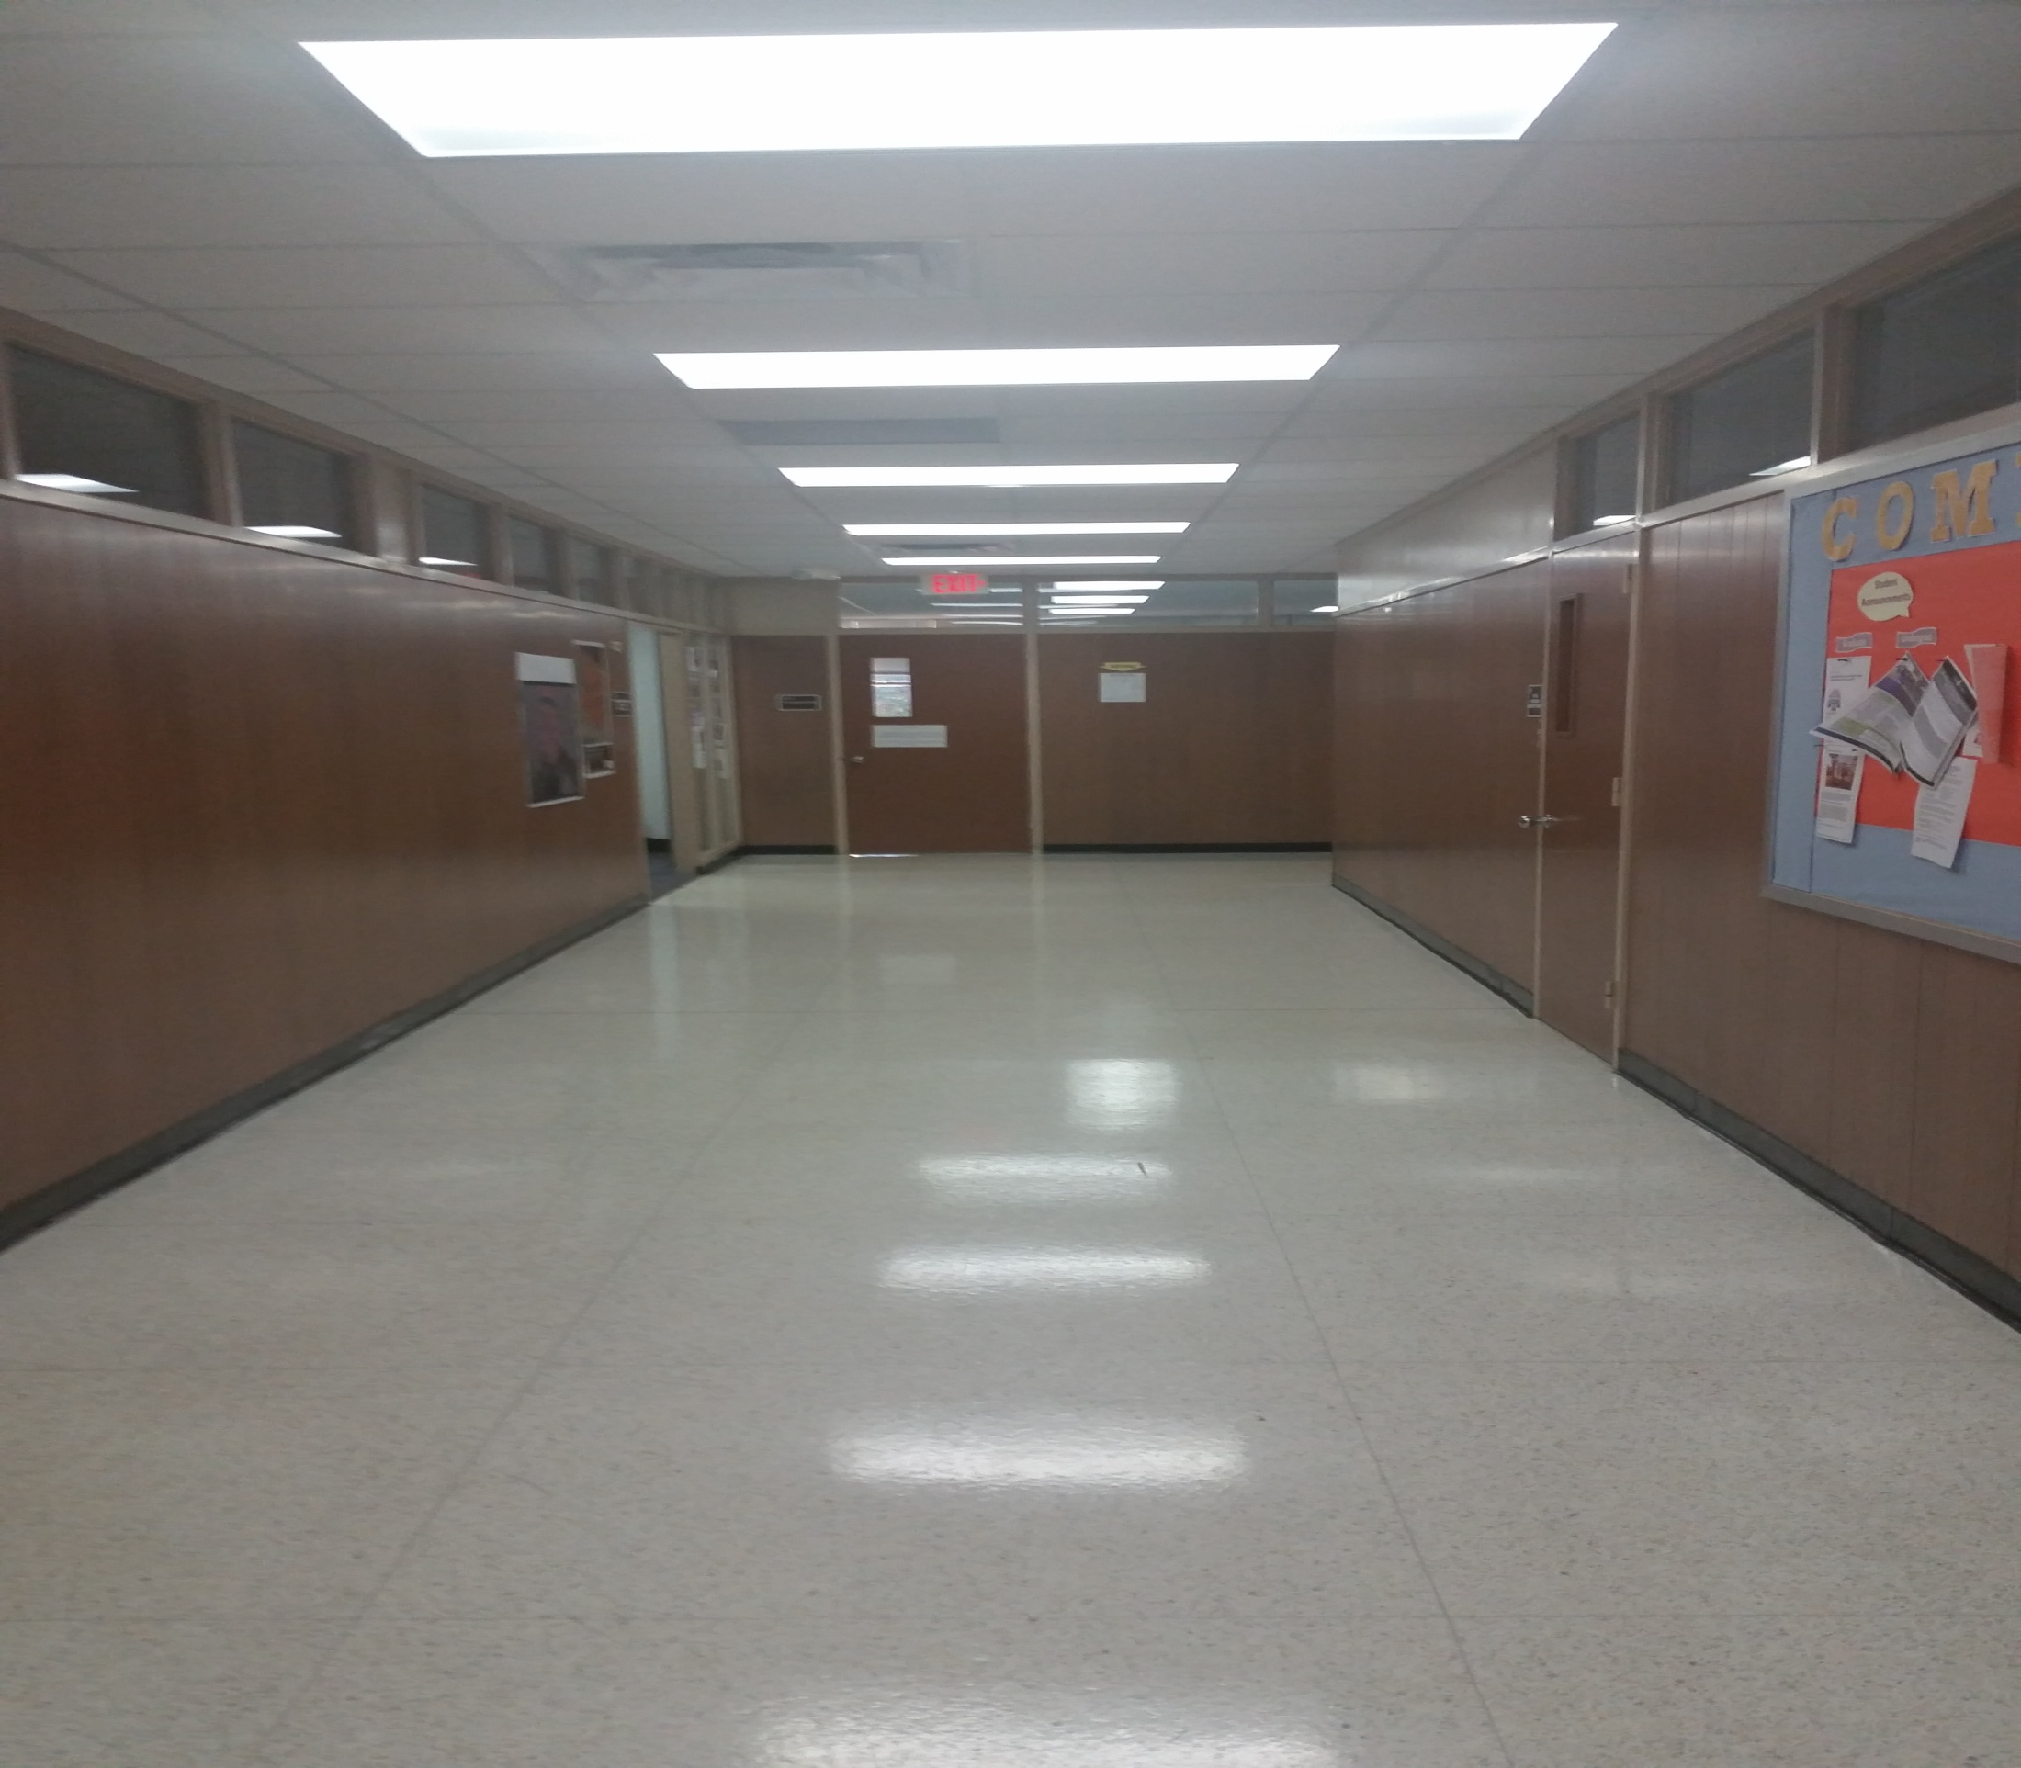
Right 7

Slide 15
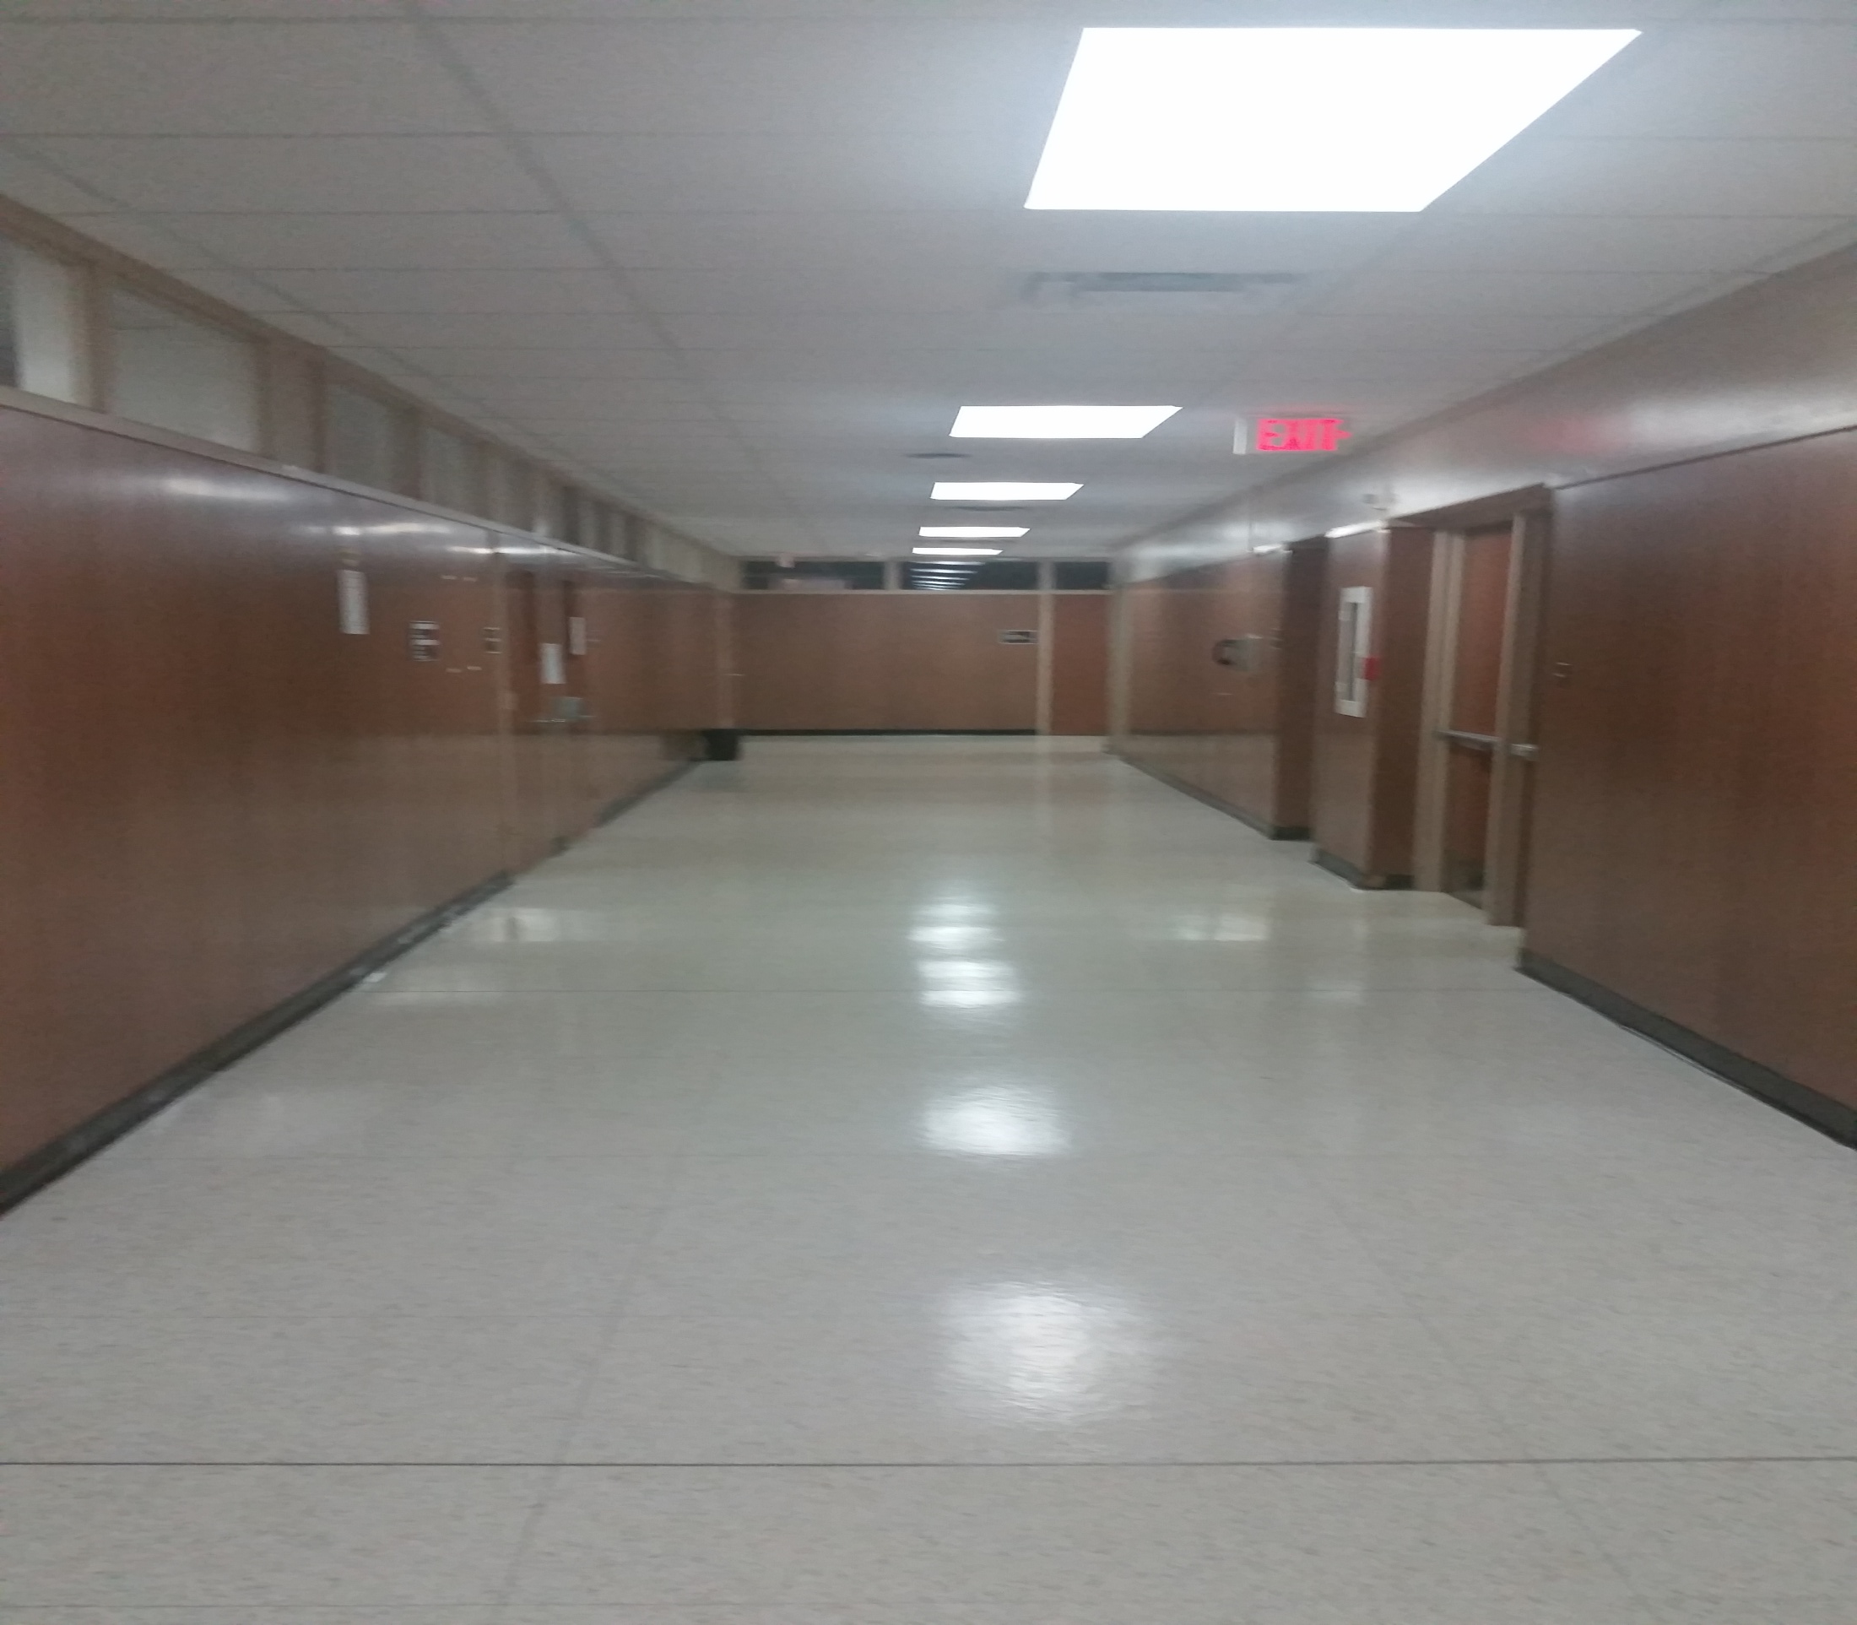
Right 8

Slide 16
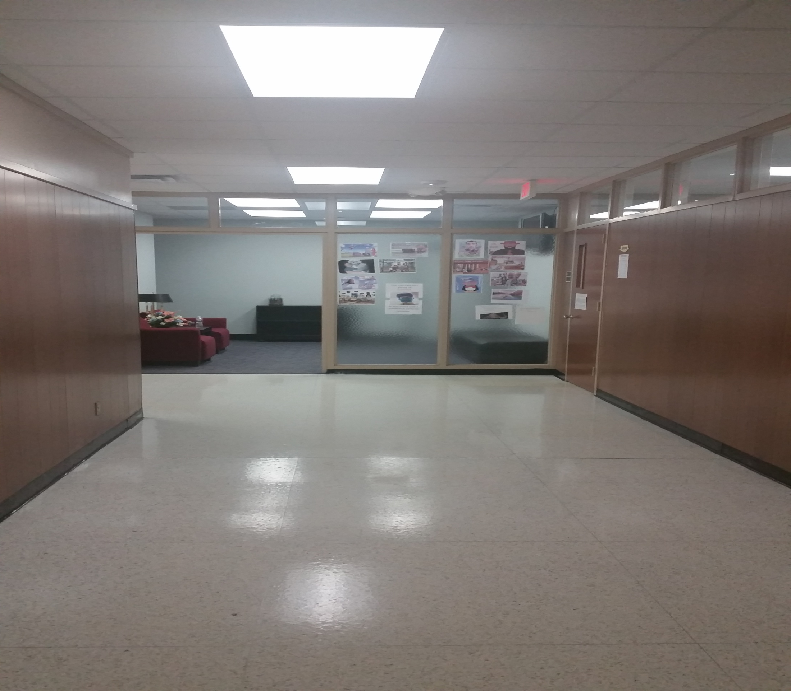
Left 1

Slide 17
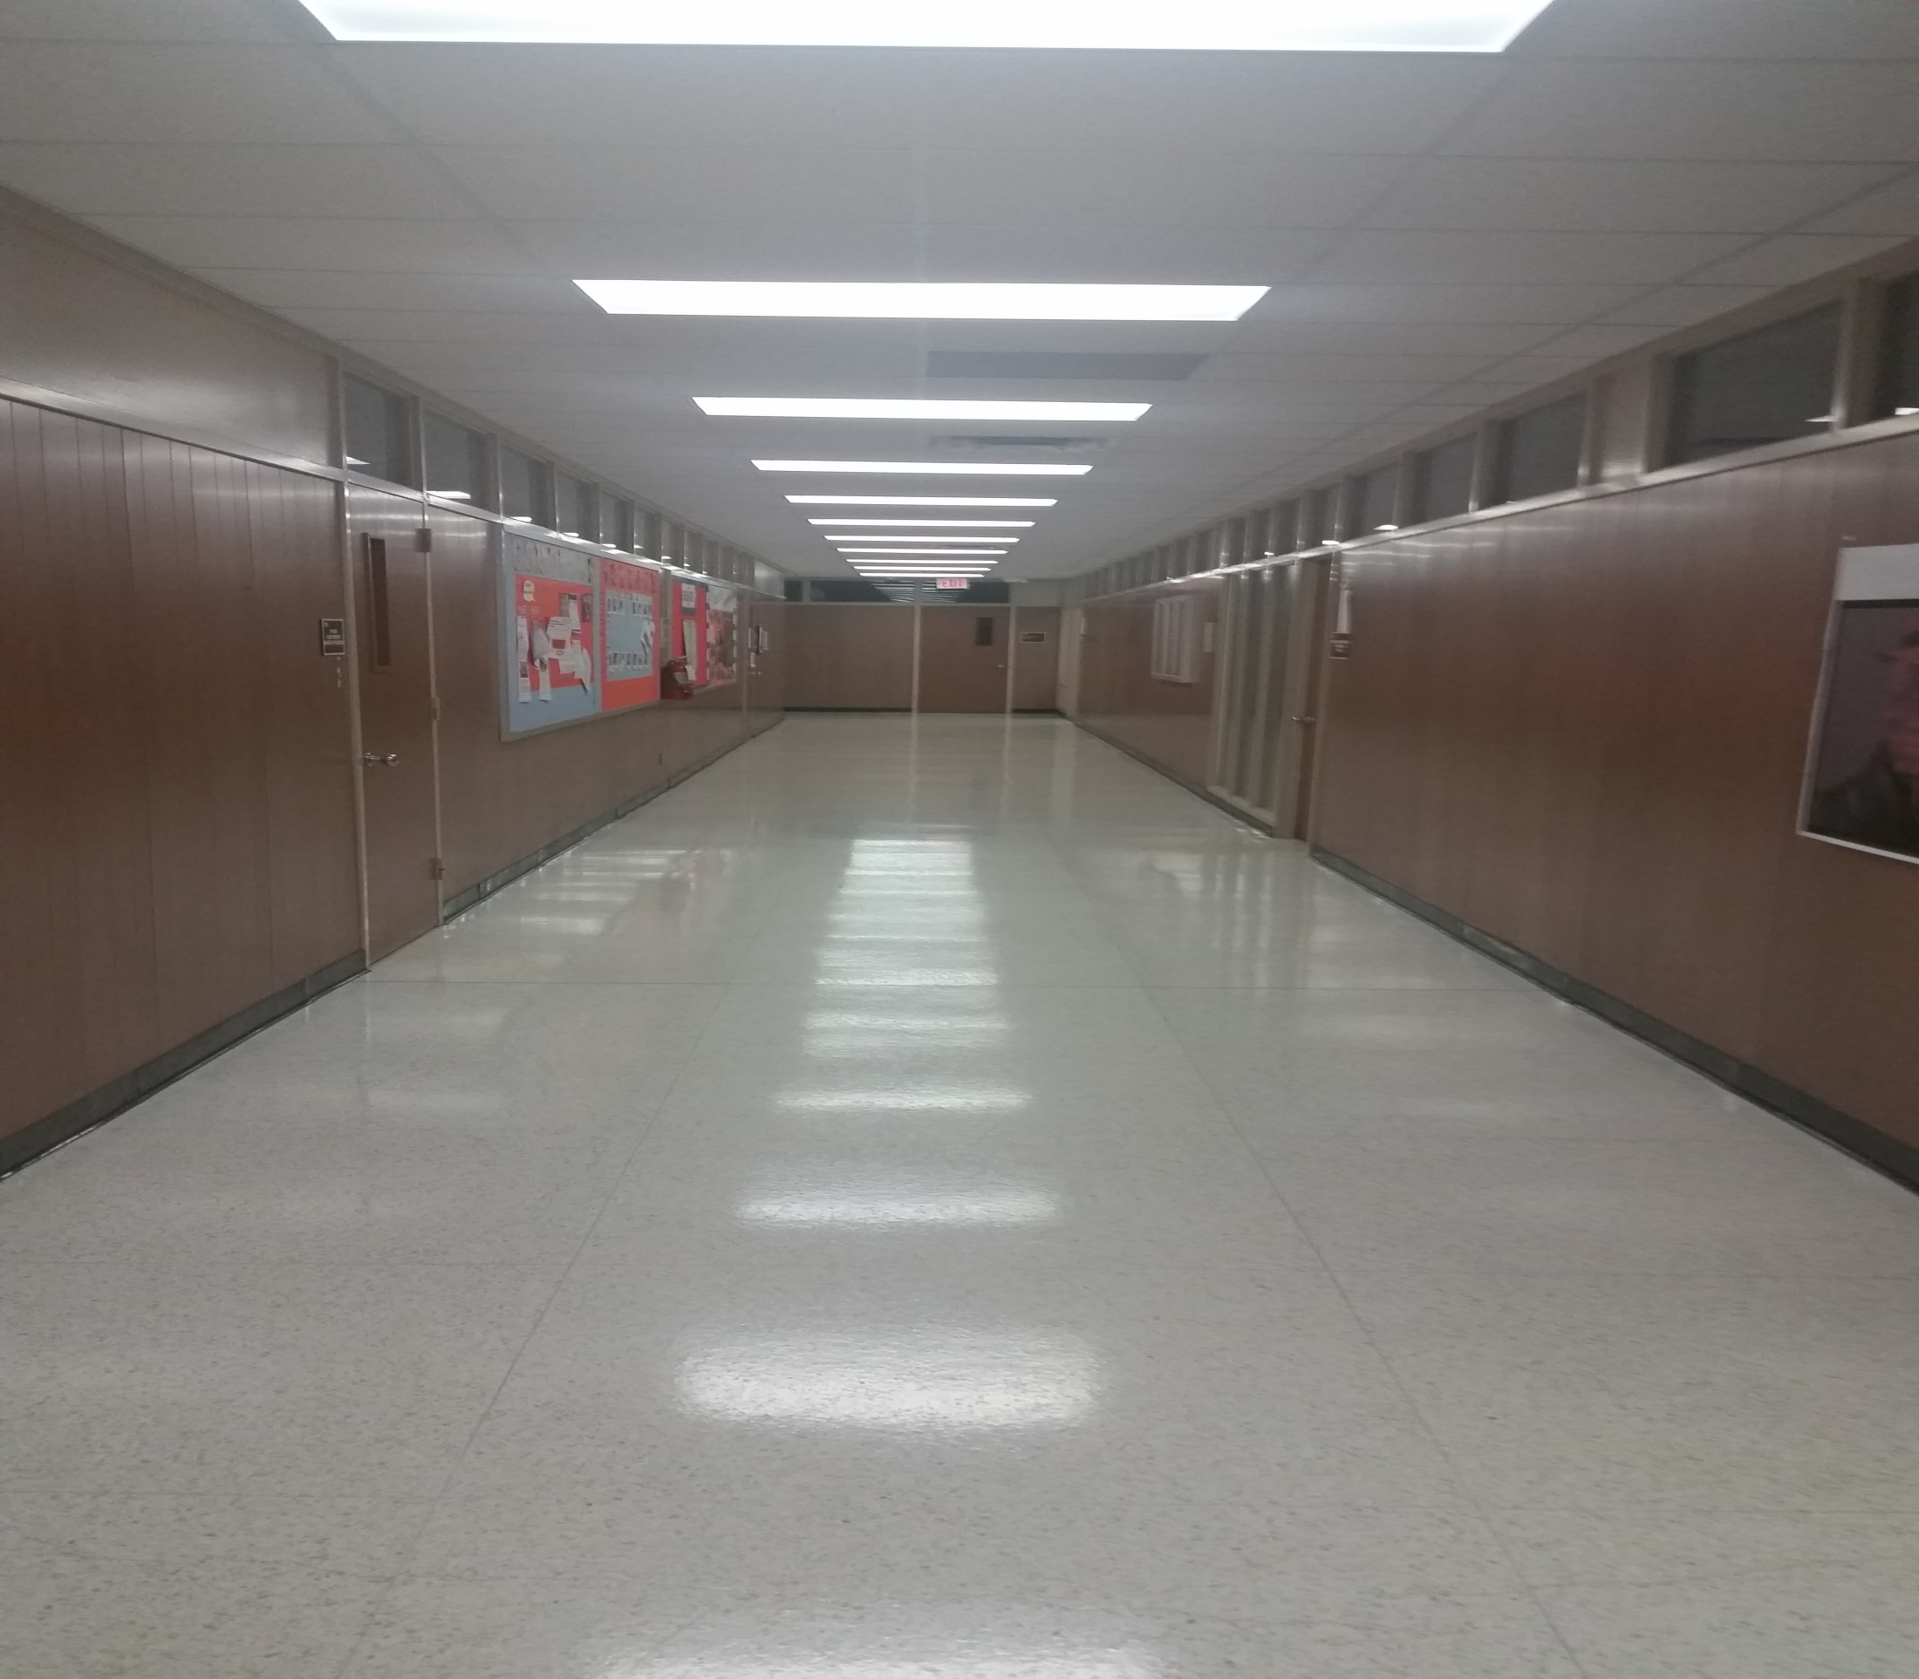
Left 2

Slide 18
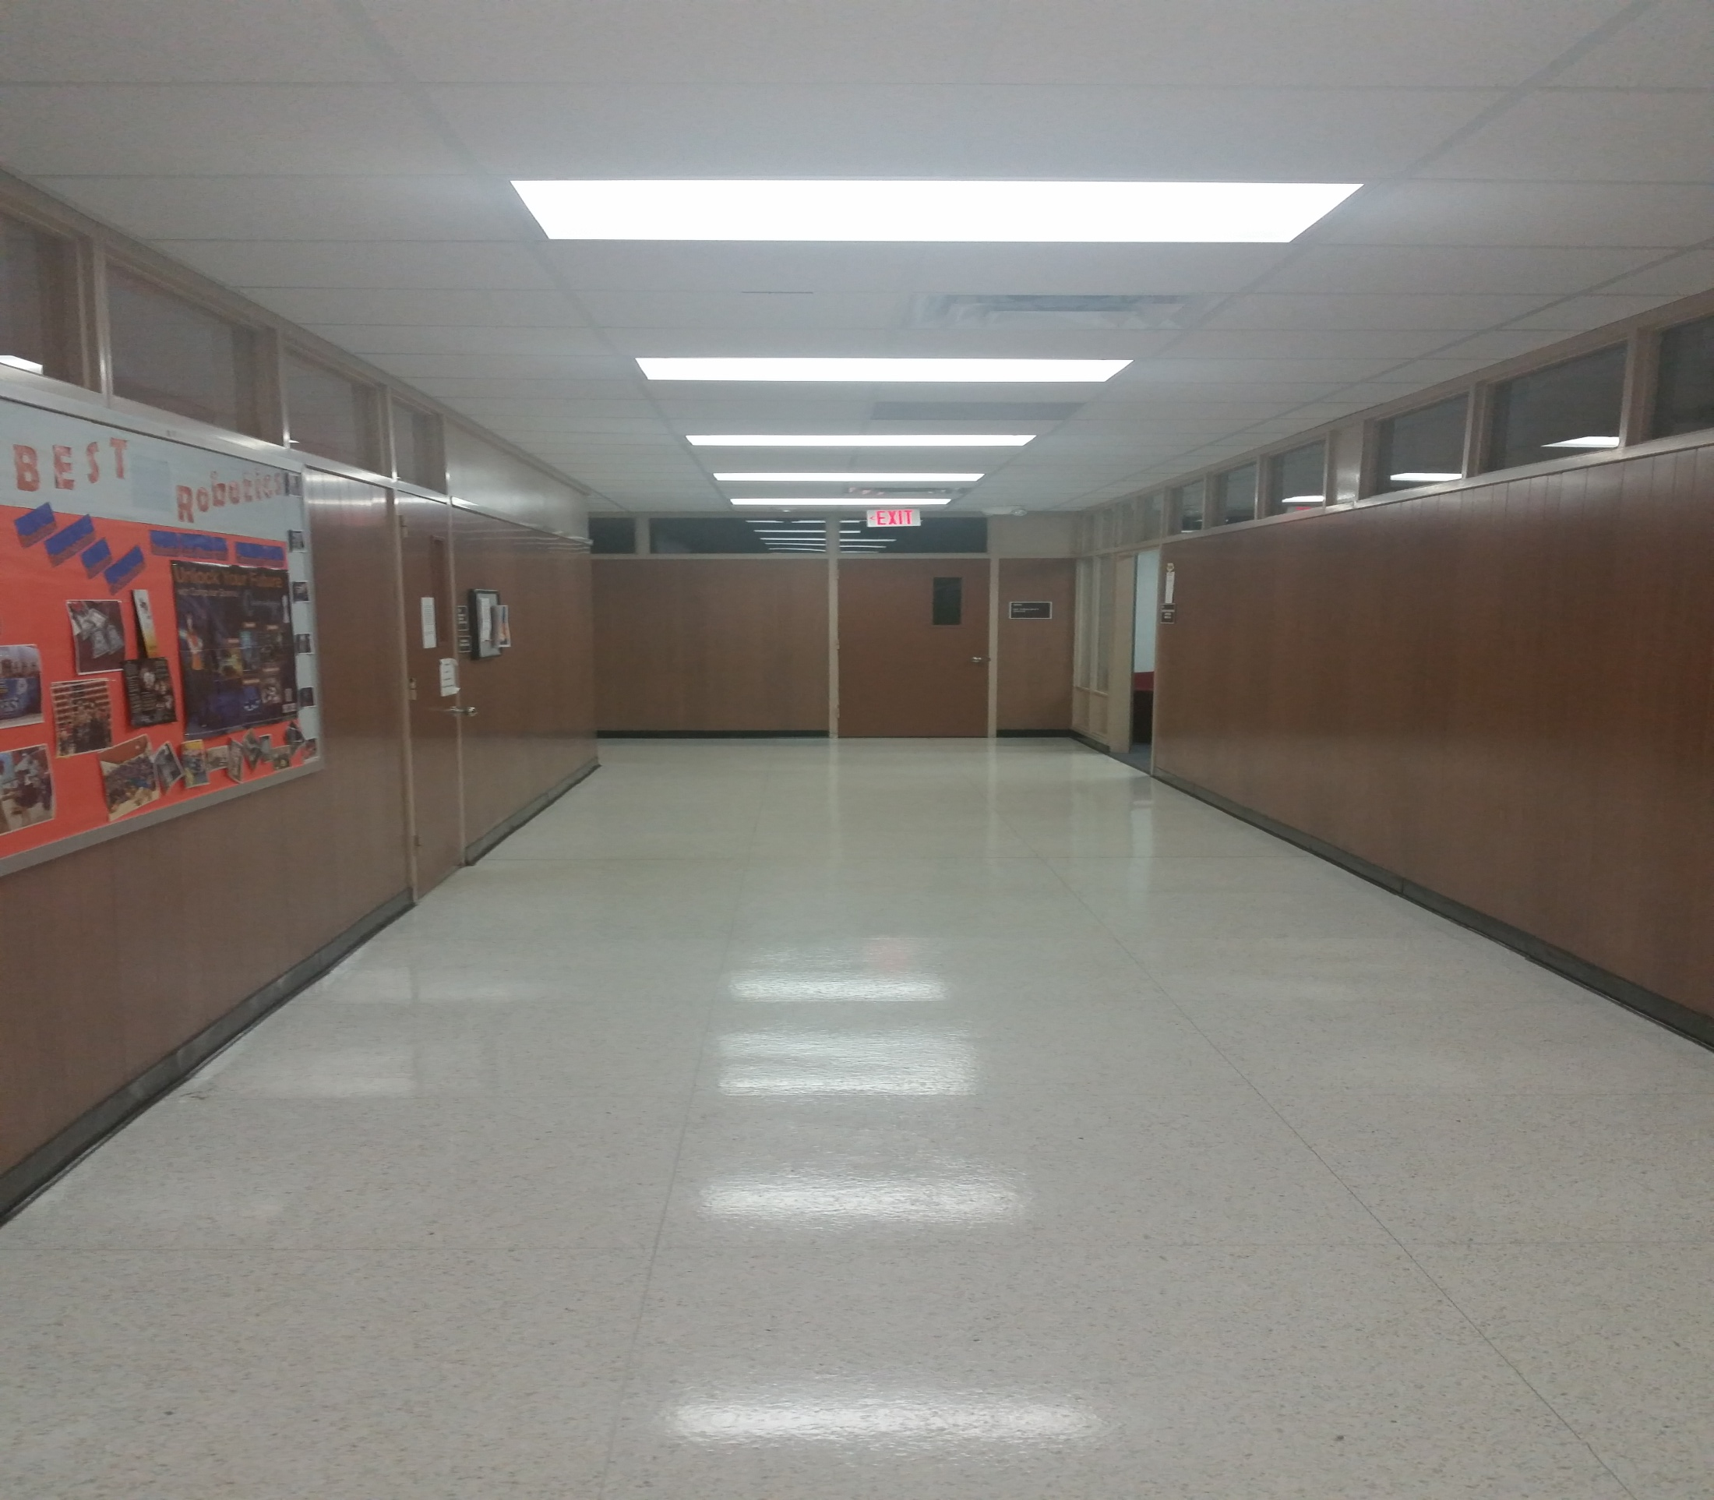
Left 3

Slide 19
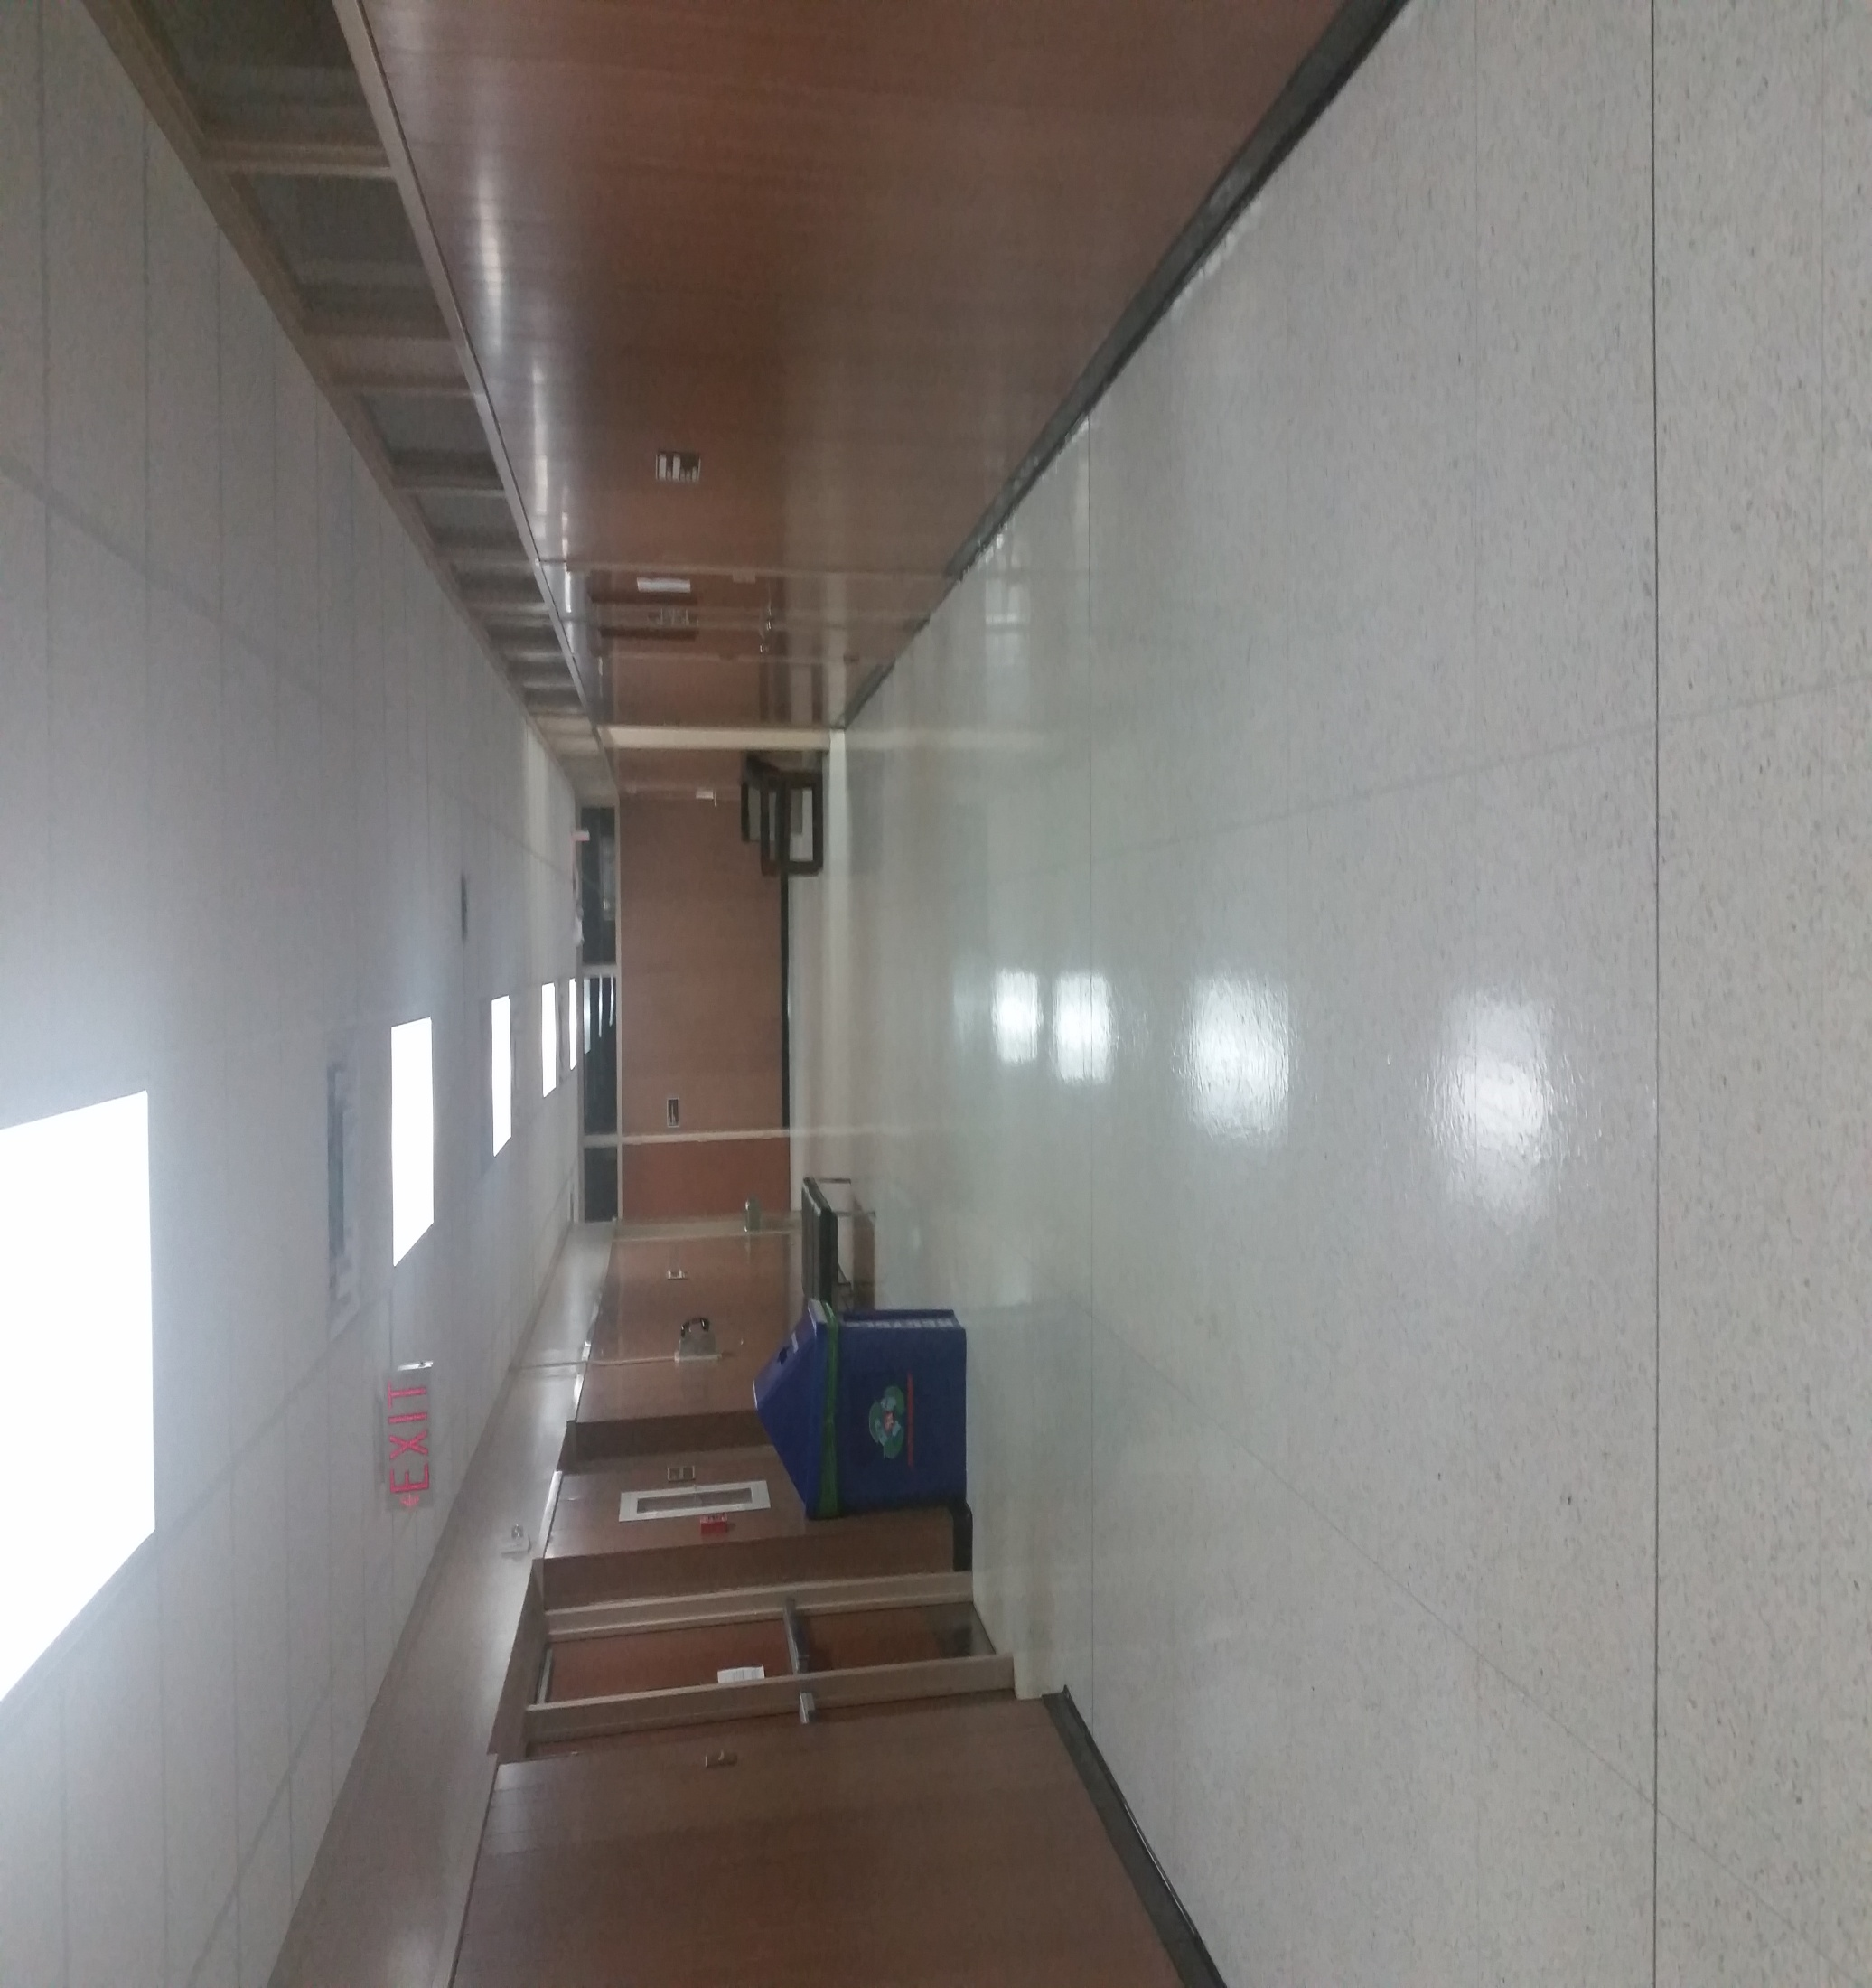
Left 4

Slide 20
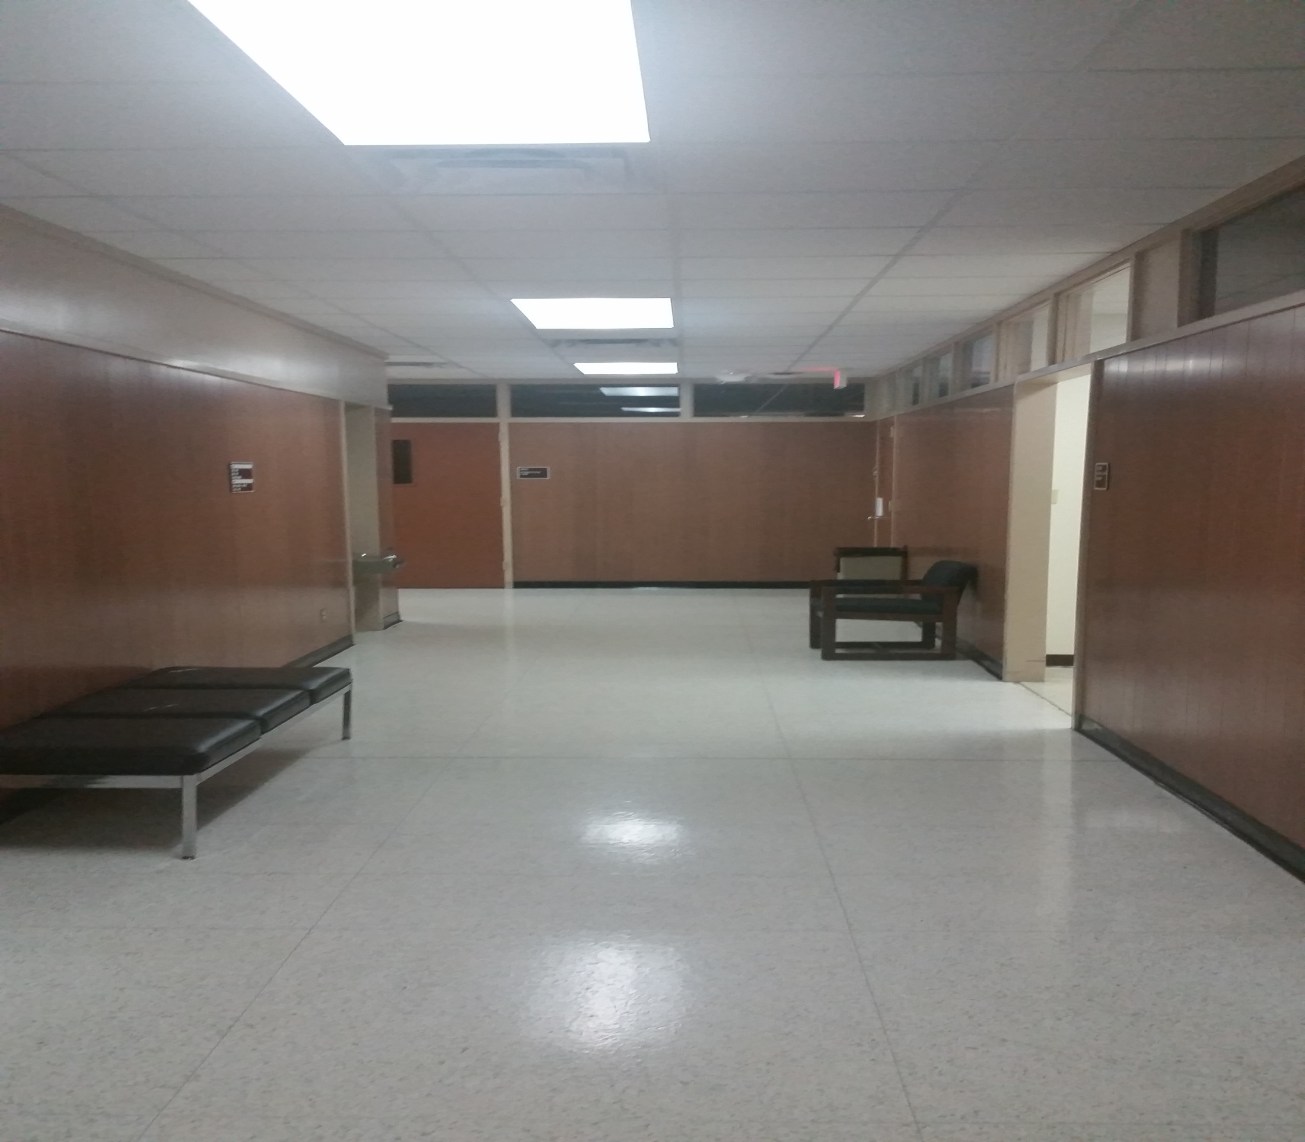
Left 5

Slide 21
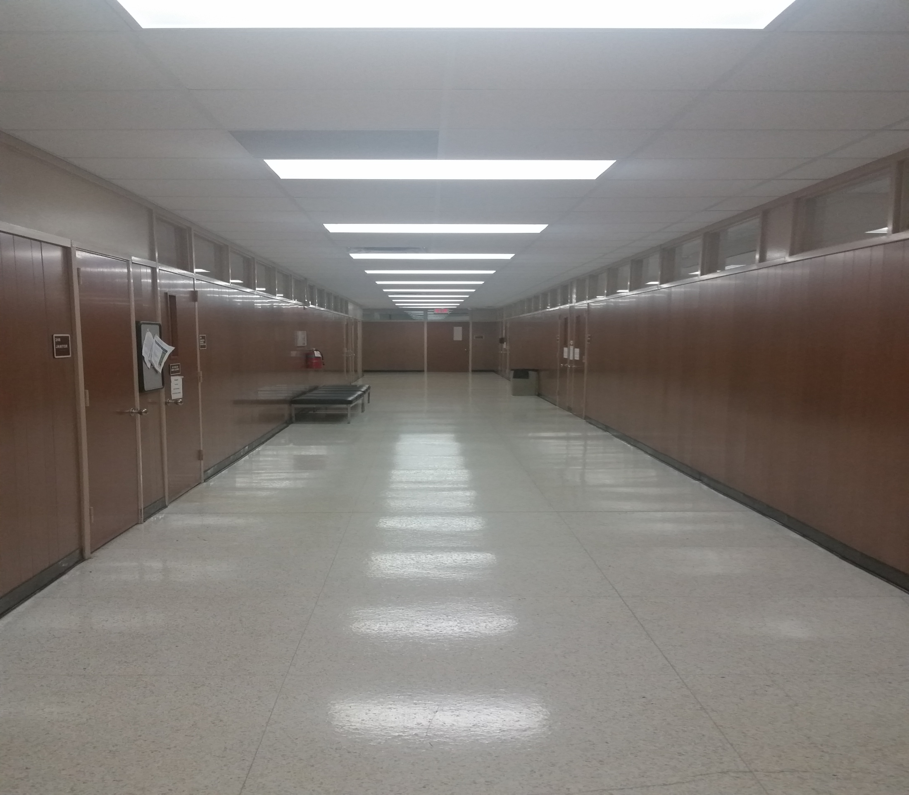
Left 6

Slide 22
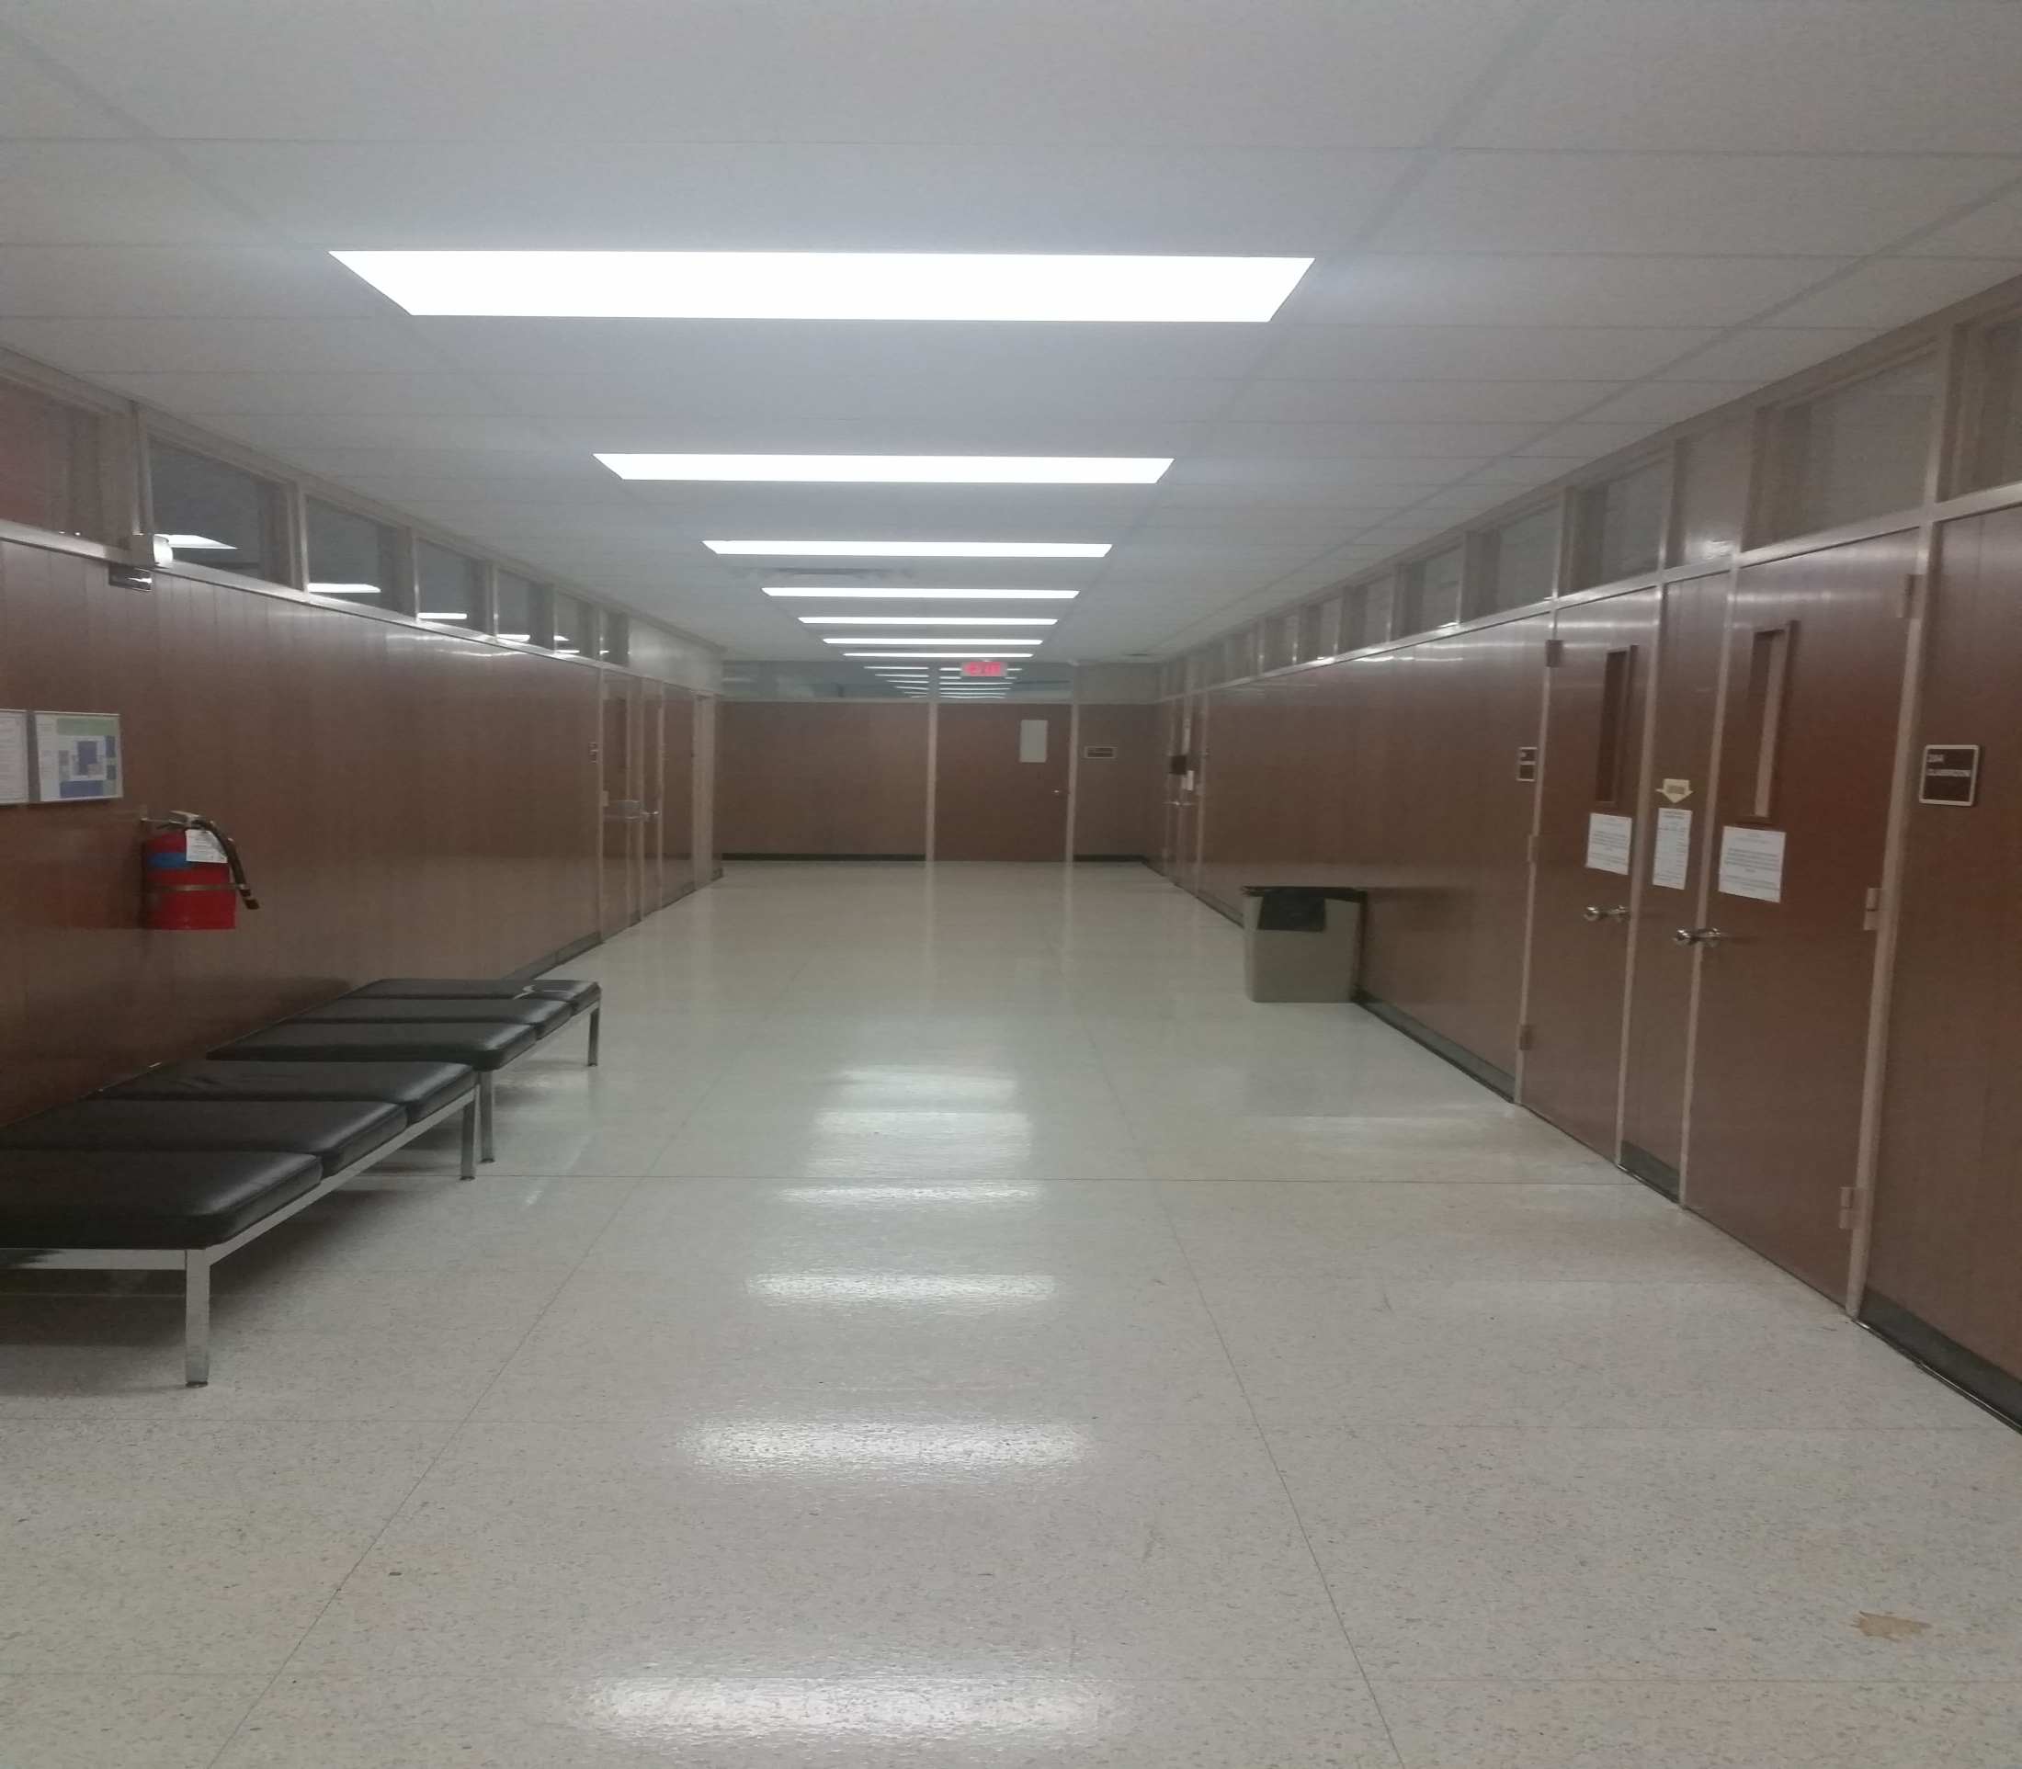
Left 7

Slide 23
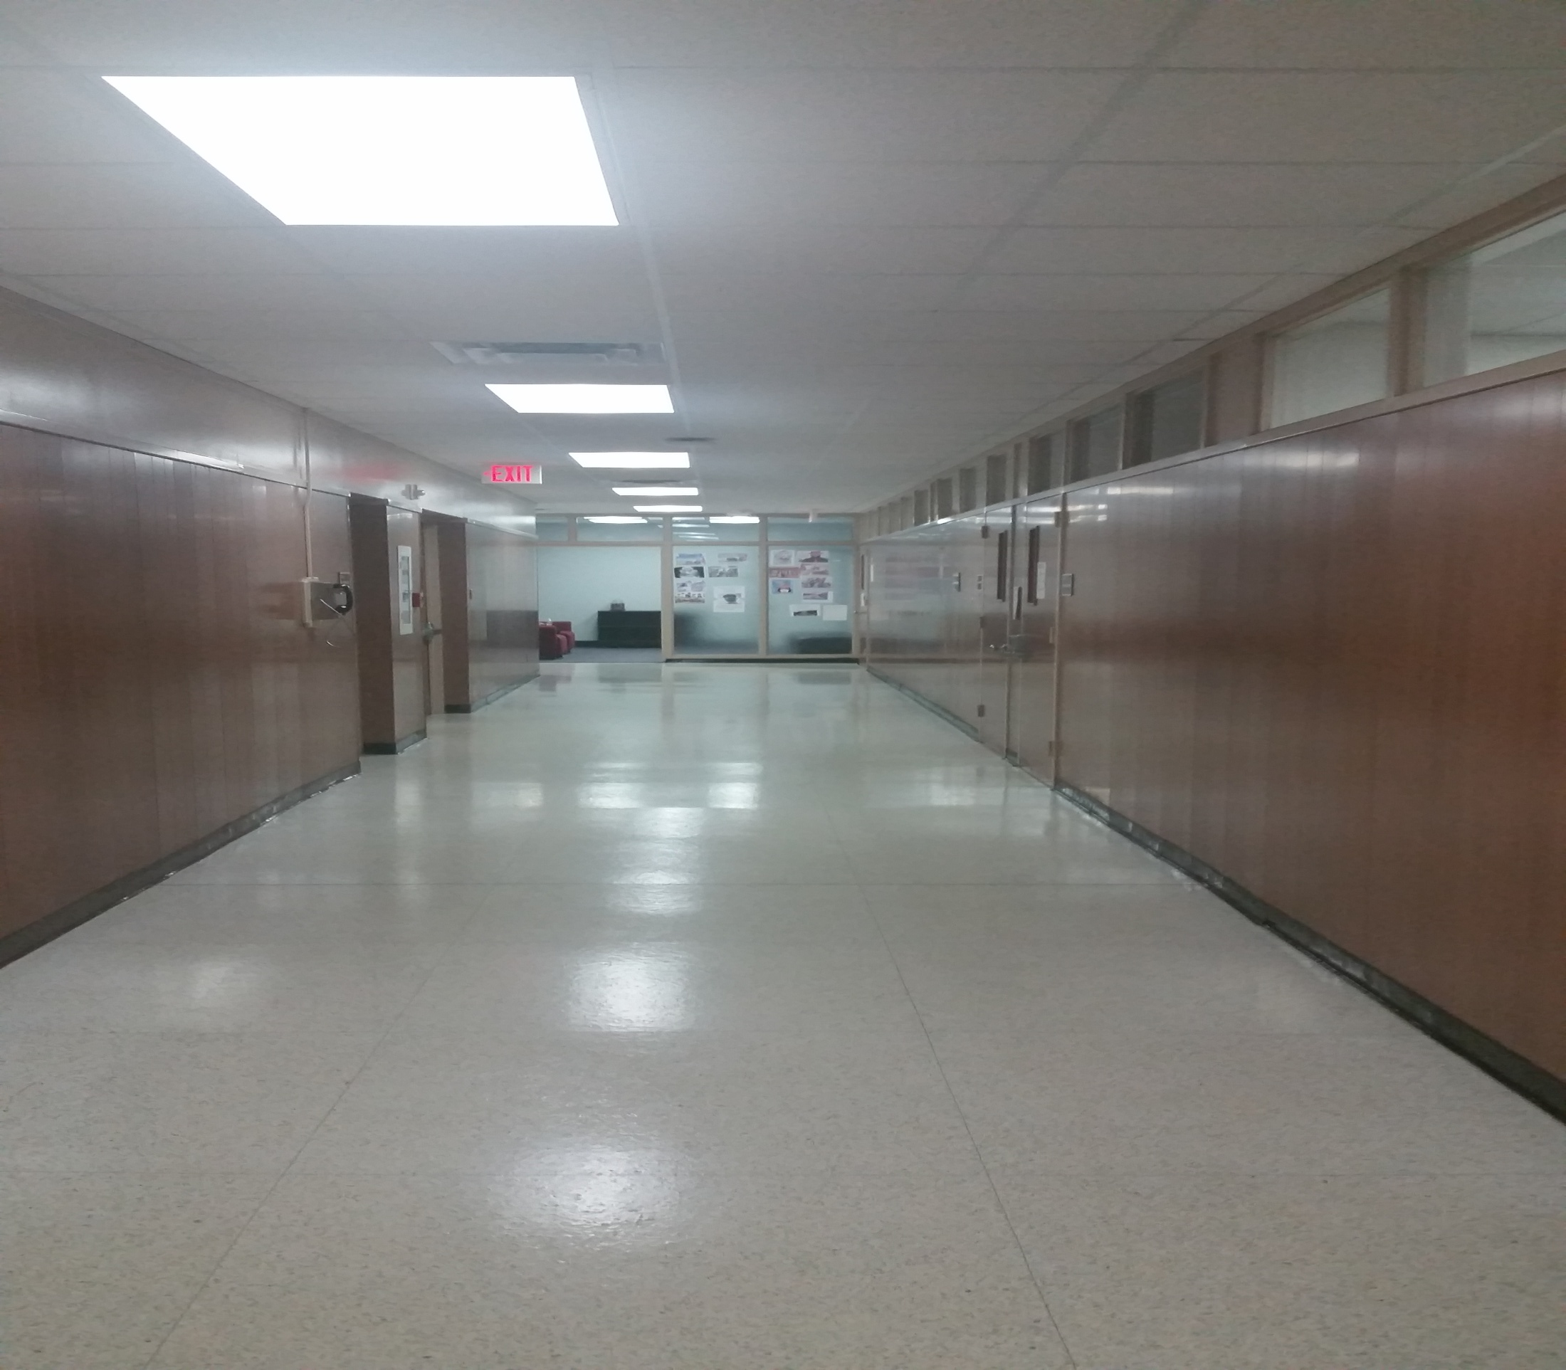
Left 8

Slide 24
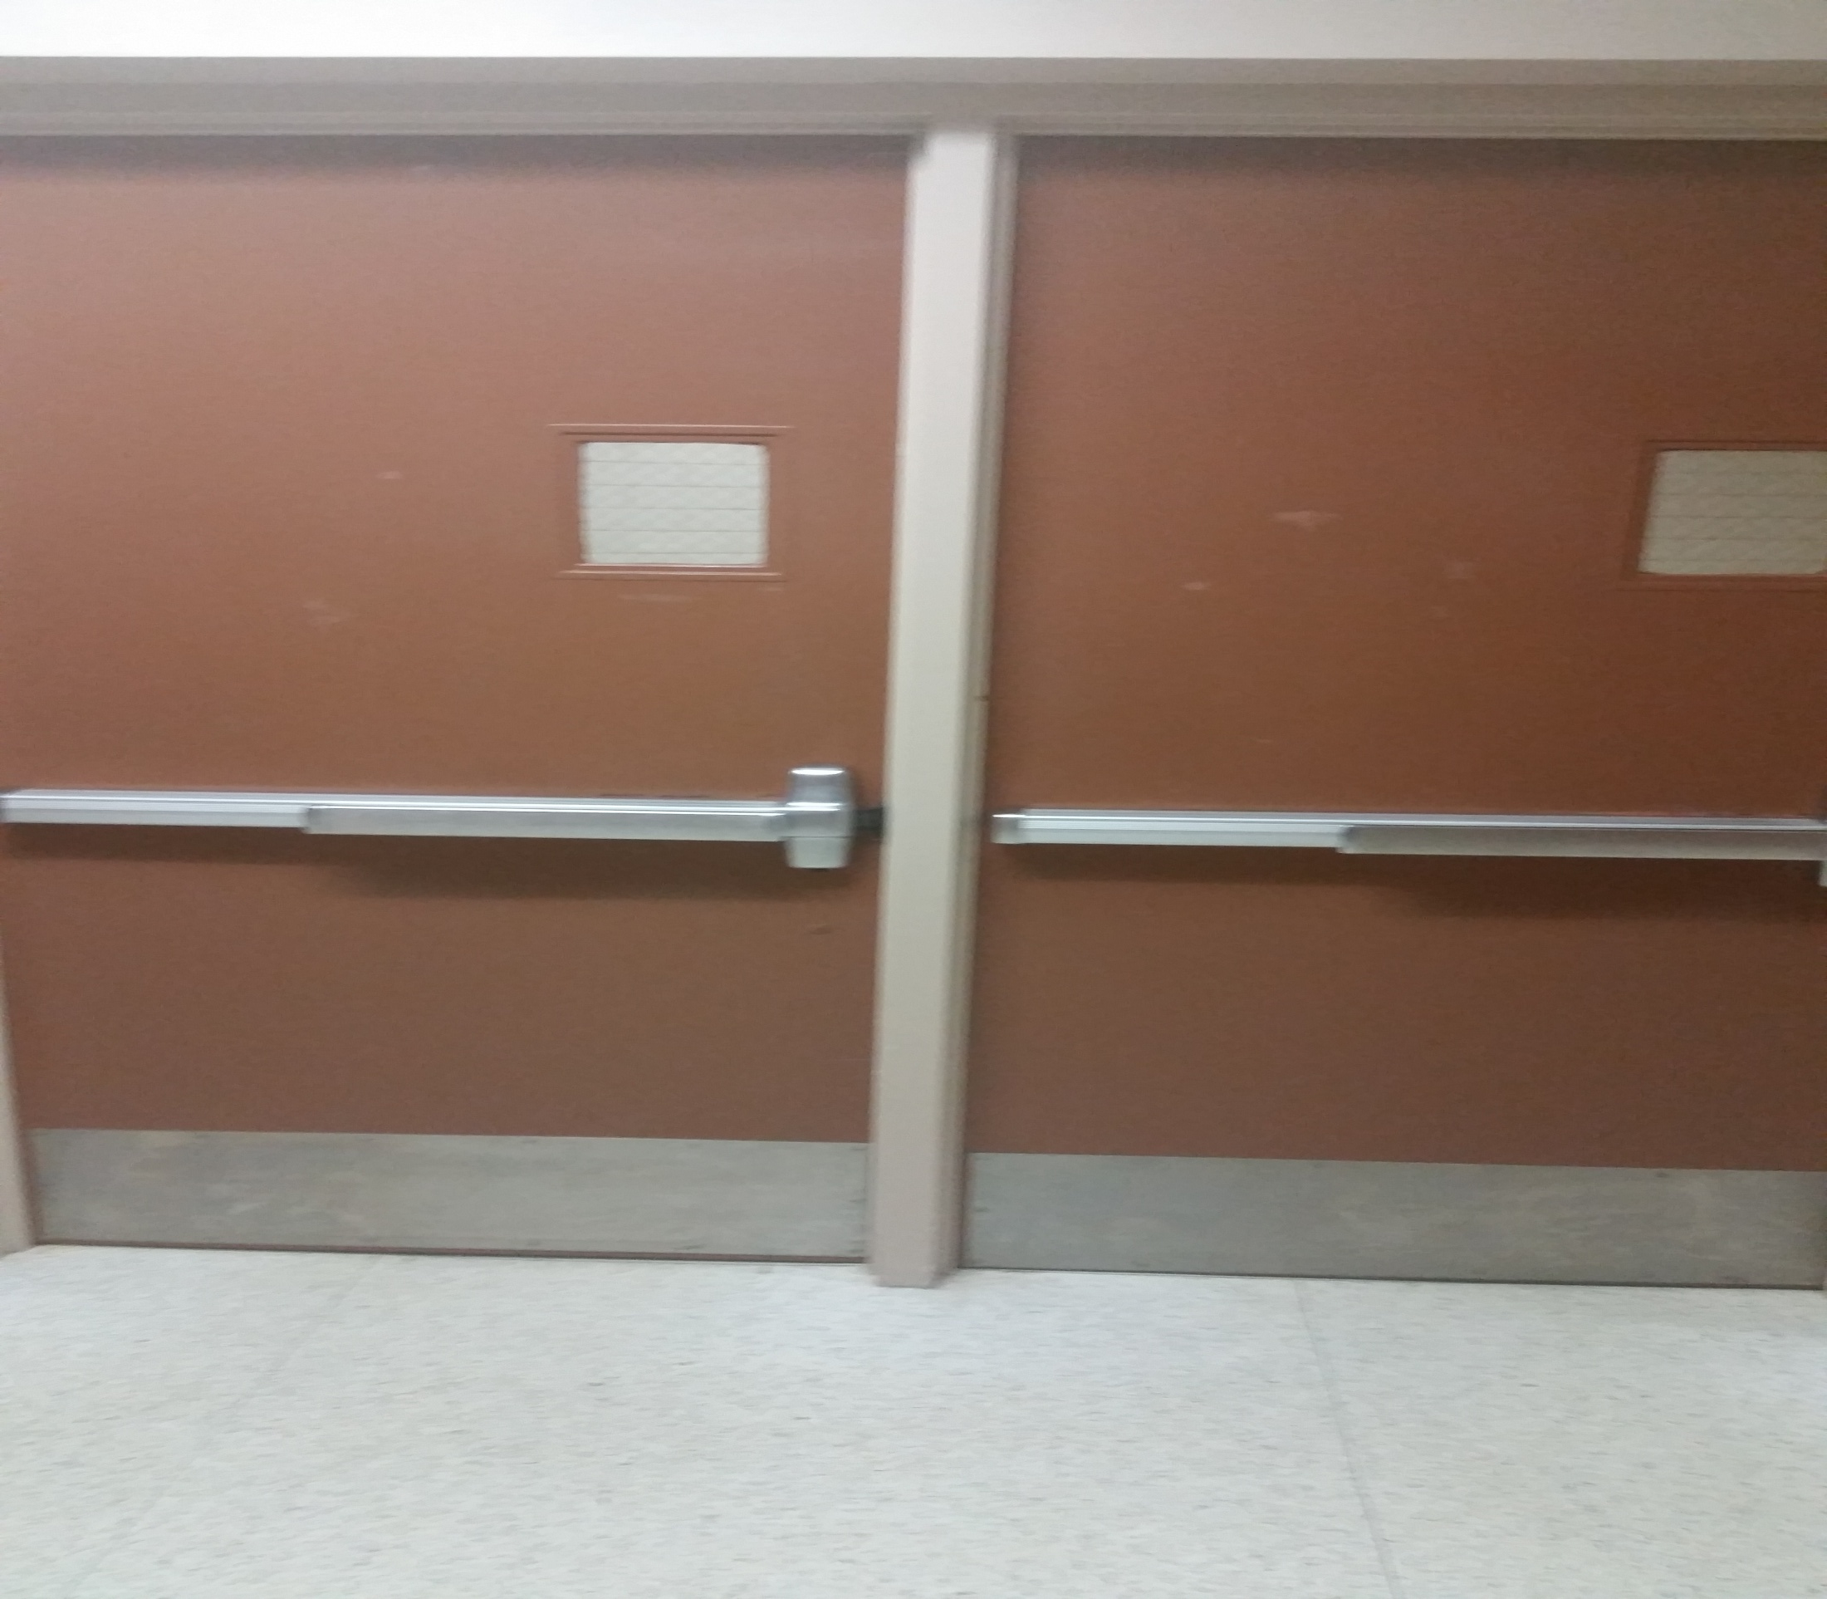
Look stair door

Slide 25
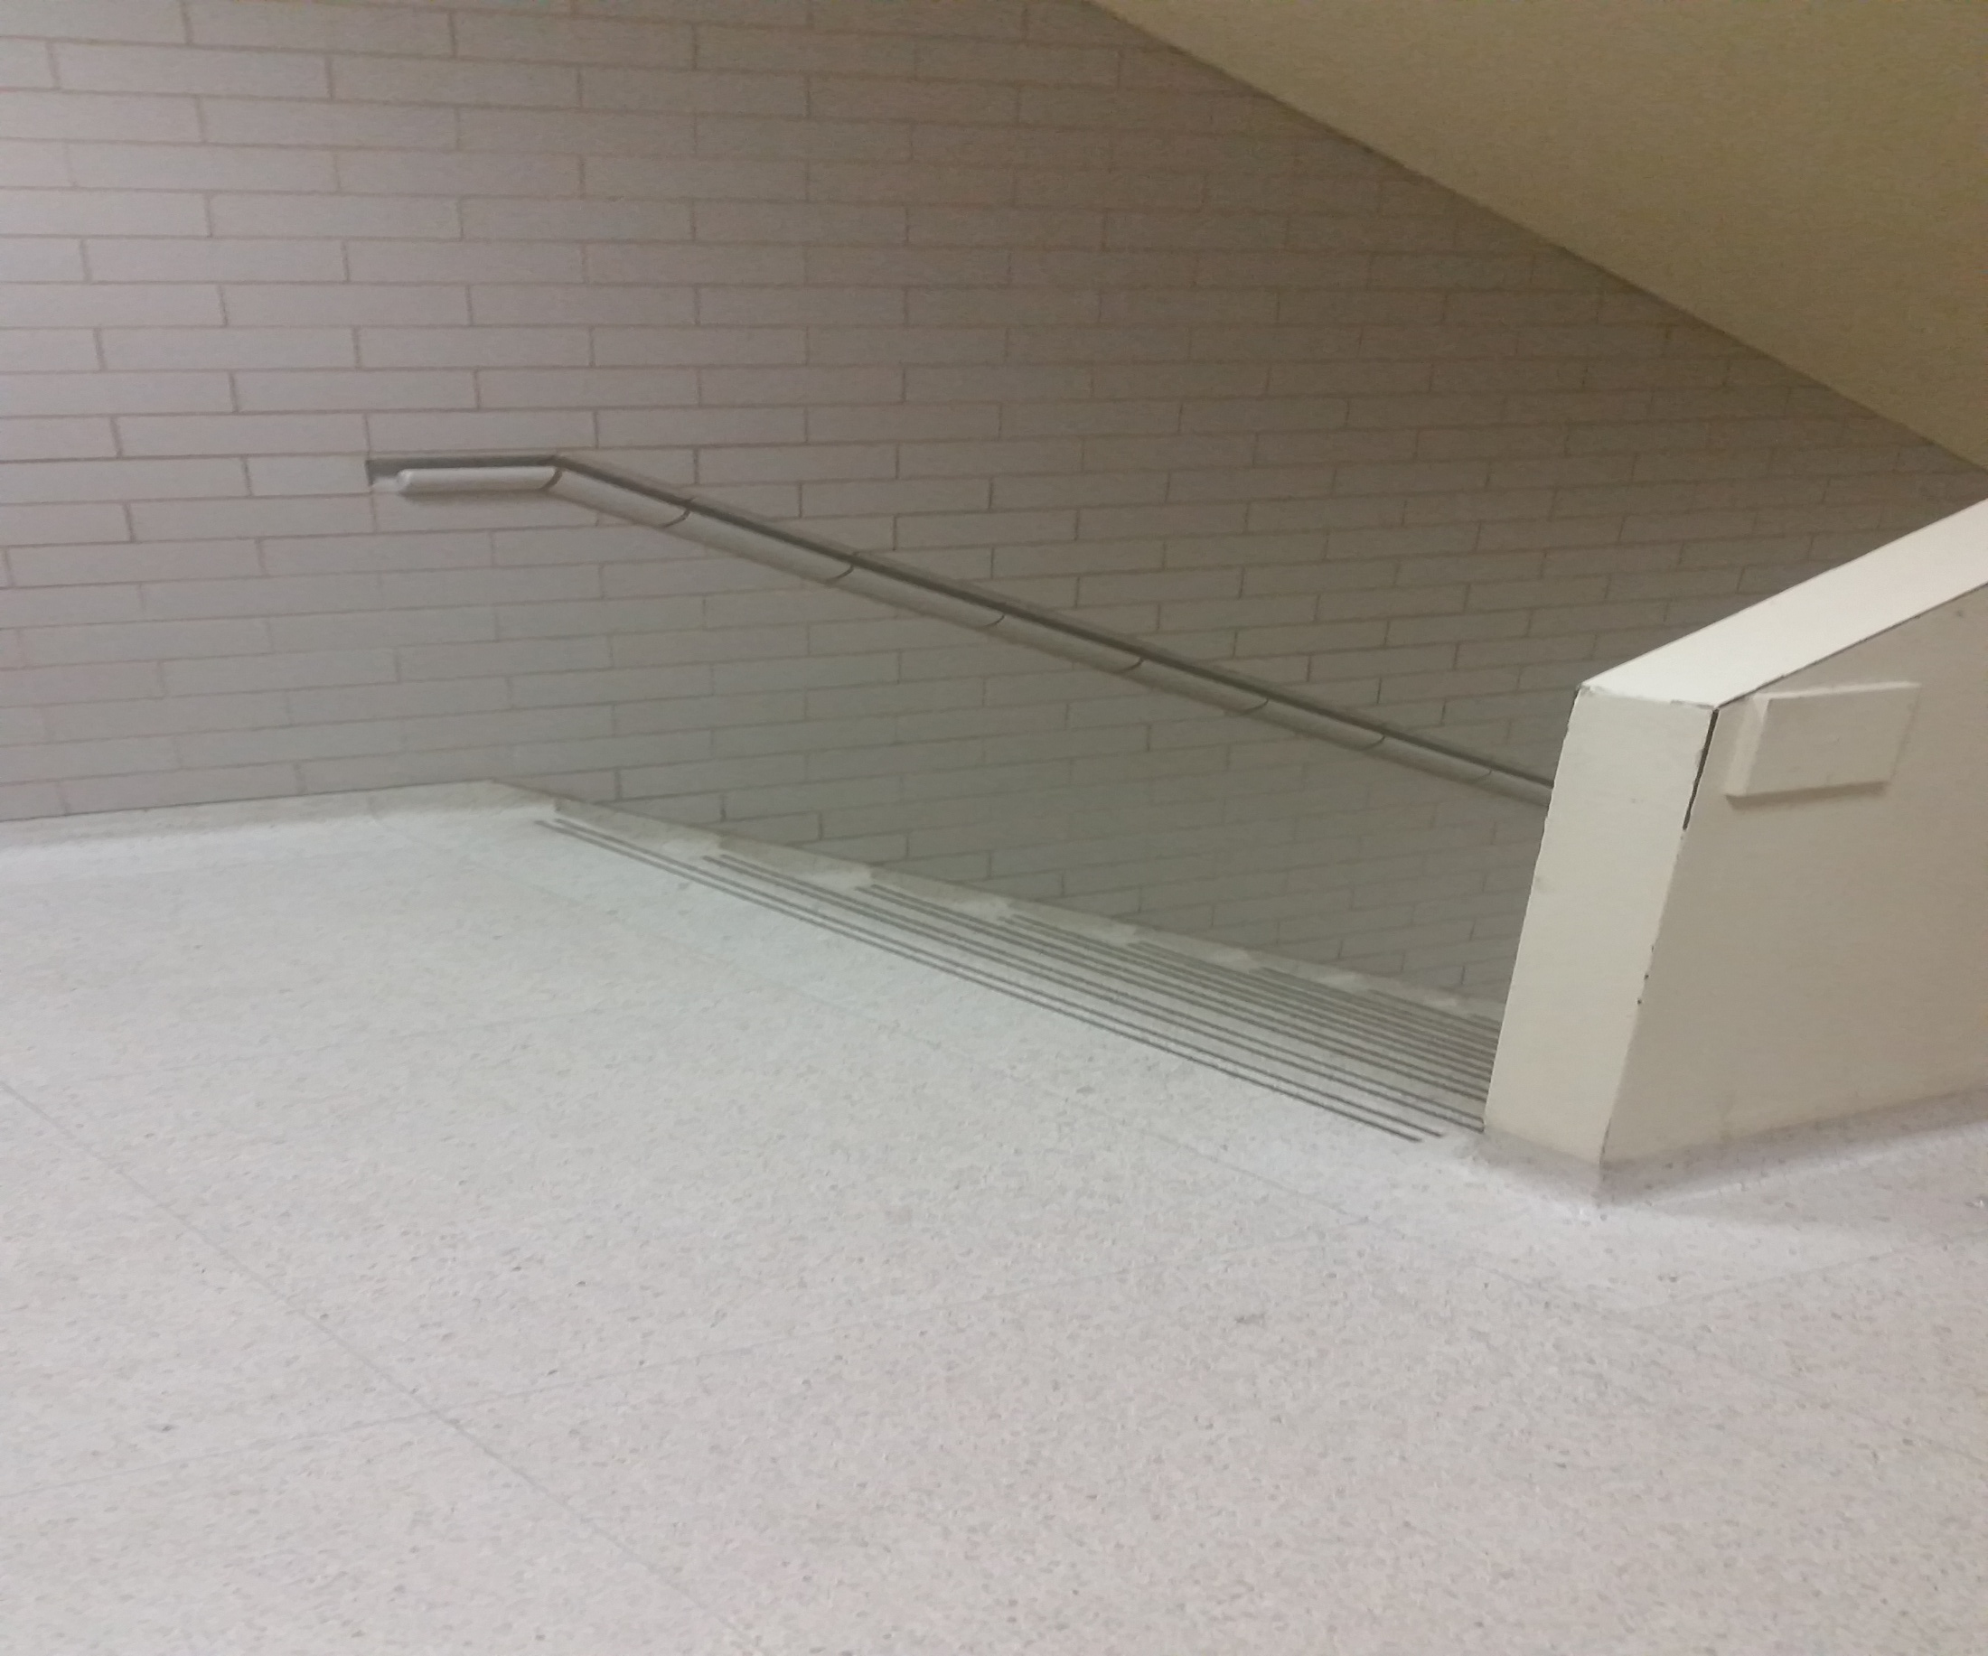
Top of stairs looking down

Slide 26
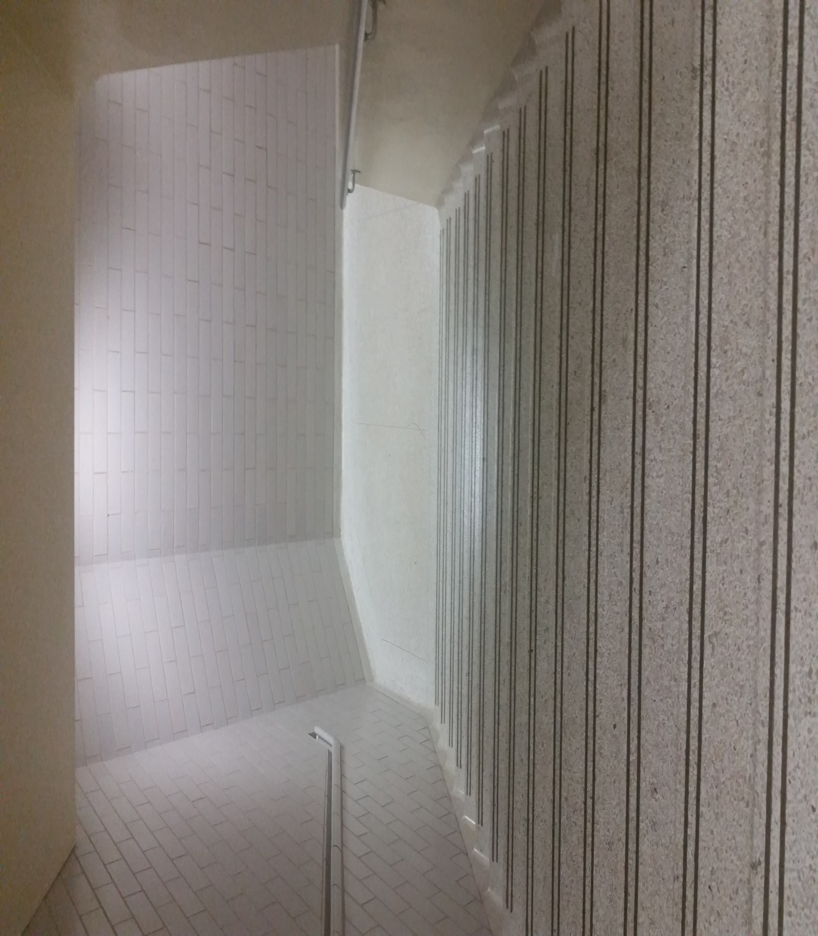
Going down pt1

Slide 27
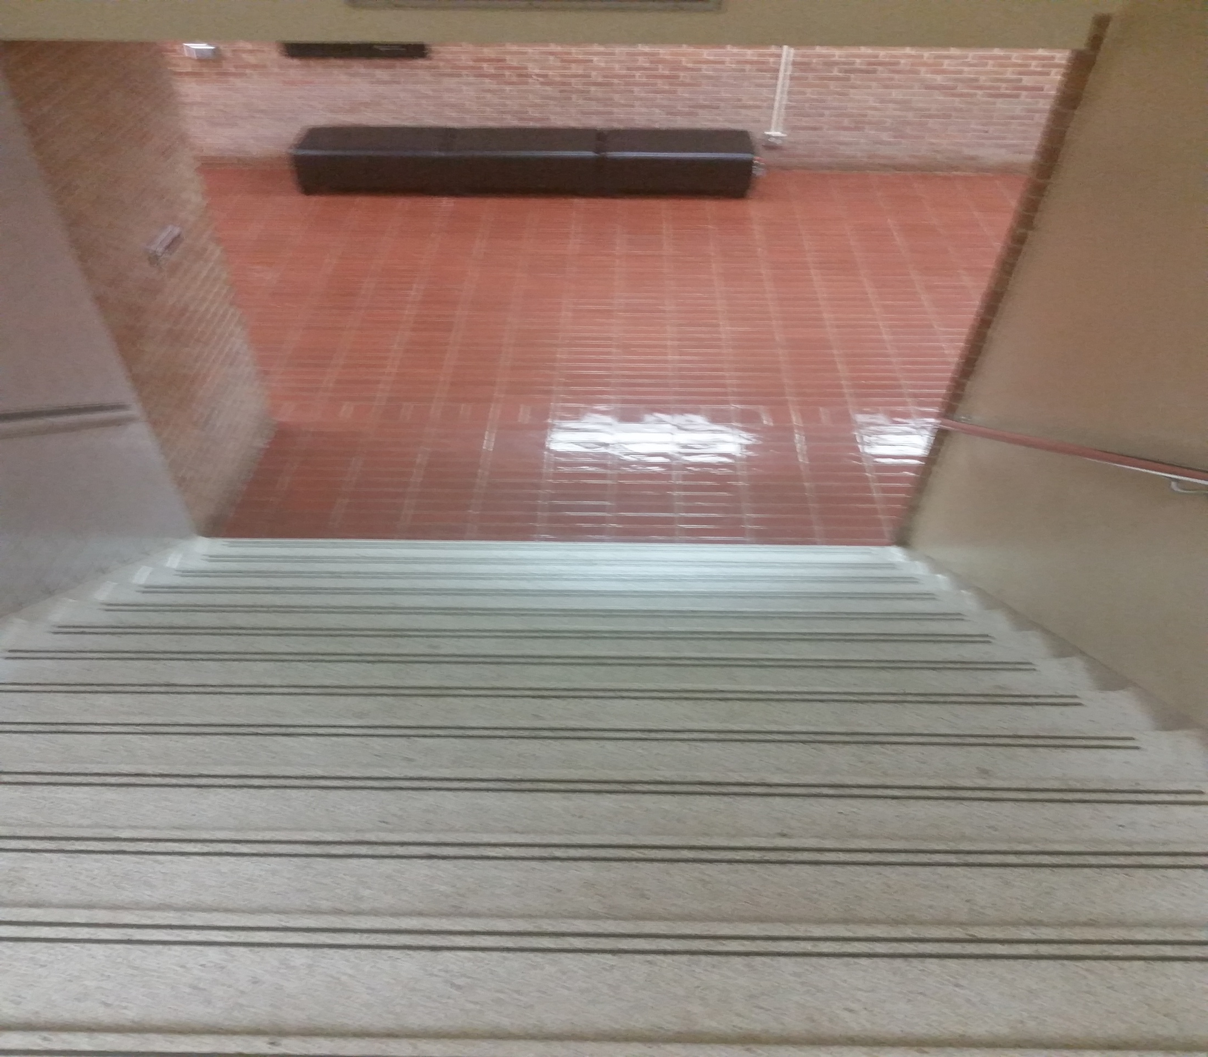
Going down pt2

Slide 28
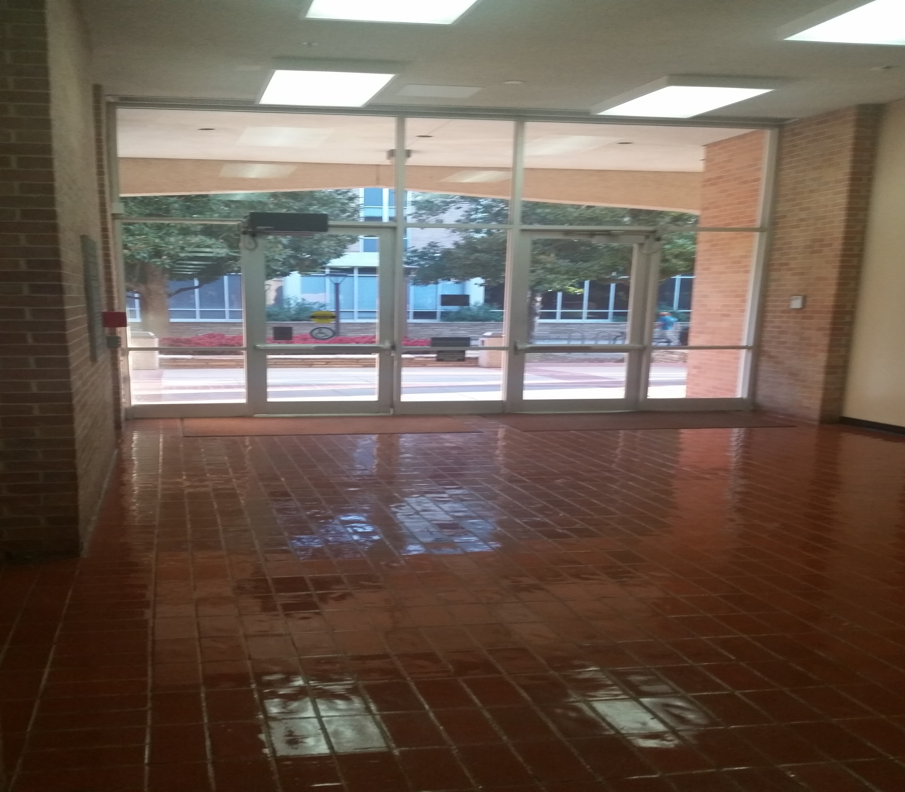
Looking toward exit

Slide 29
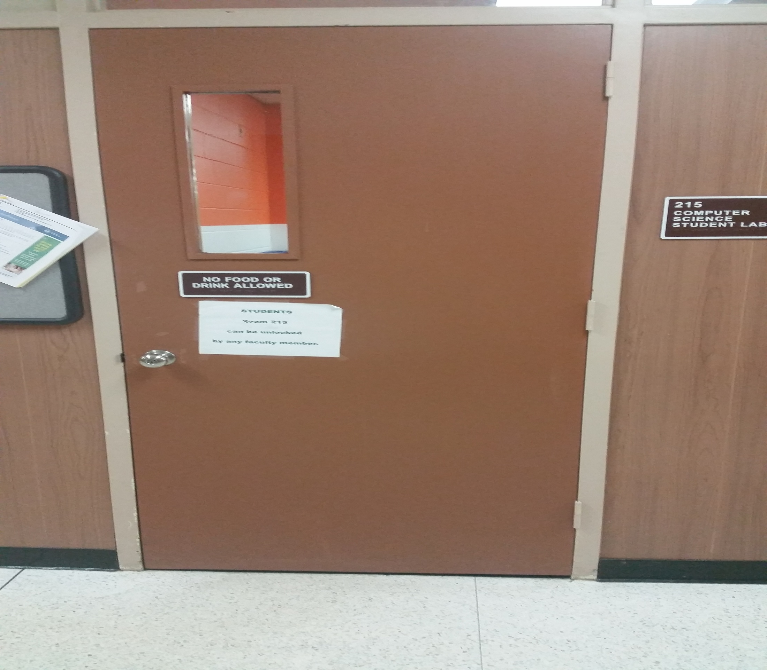
Entering SHACS Room Door 1

Slide 30
SHACS 1
couches

Slide 31
SHACS 2
couches

Slide 32
Leaving Through SHACS Room 2

Slide 33
SHACS 4
couches

Slide 34
SHACS 5
Long Table
couches

Slide 35
Leaving SHACS Room Through Door 1

Slide 36
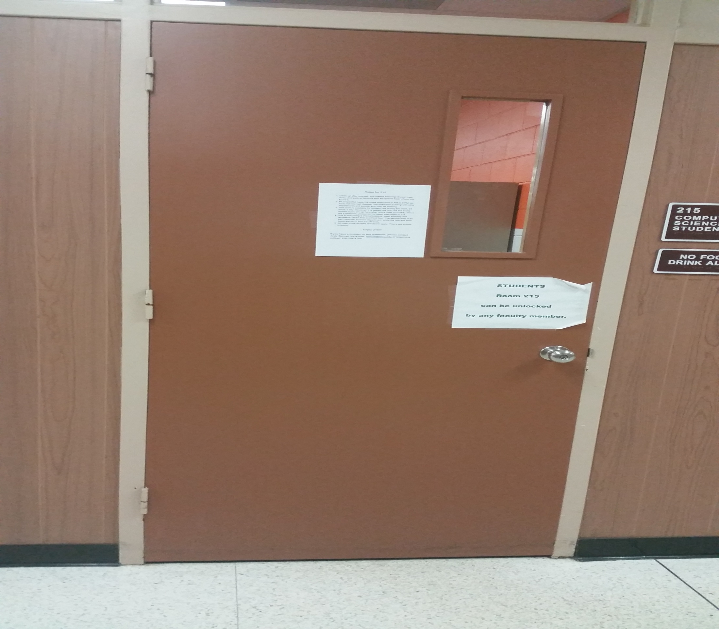
Entering SHACS Room Door 2

Slide 37
Standing outside SHACS Door 1

Slide 38
Standing outside SHACS Door 2

Slide 39
Outside of AB1

